Slide 1



Meet the Teacher - Year 1

Slide 2



Who's Who

Slide 3

NMR 2025/6
Sycamore Class
Miss Morgan
Cherry Class
Mrs Nightingale
Mrs Lambert
Year 1 Teaching Staff Support
Mrs Forey
Mrs Noad

Slide 4

Curriculum

Slide 5

NMR 2025/6
Curriculum content in Year 1
Autumn 2026 | Spring 2027 | Summer 2027
Here come the bears! | Passports at the Ready | Castles and Dragons

Slide 6

Reading

Slide 7
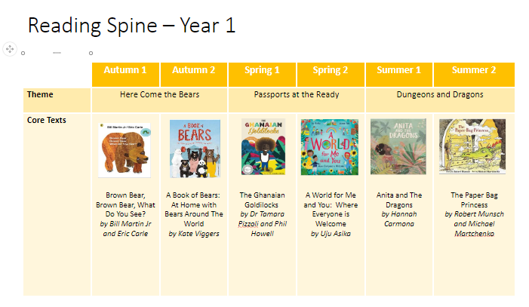

Slide 8
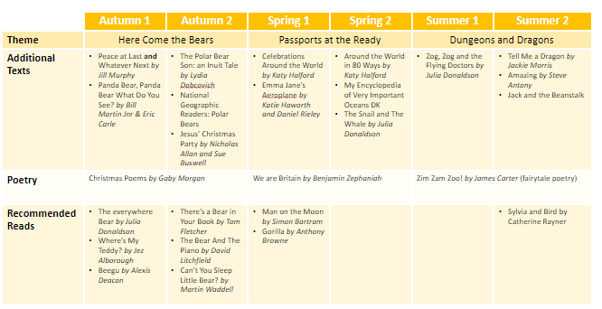

Slide 9

Reading Books
Small group guided reading sessions. Reading books will go home on Wednesdays following on from the guided reading sessions.
Reading across a range of books including fiction, non-fiction, poetry.​​
Book levels may alter as a result of ongoing assessments.​​ Children will repeat books they have already read – this is to support confidence, fluency, expression and independence.
​​
How can you help?​​
Listen to your child read as often as you can. ​​
Ask questions to test your child’s understanding of what they read.​​
Read to your child – stories, library books etc. ​

Slide 10
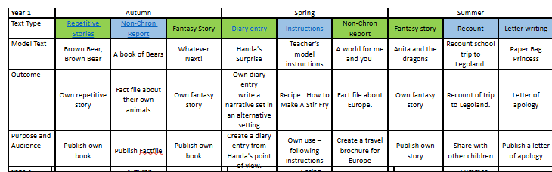
NMR 2025/6
Writing Curriculum
We cover a wide range of genres during the year:

Slide 11

Phonics

Slide 12
NMR 2025/6
Phonics
Daily phonics lesson ​
Lessons will follow the Little Wandle Letters & Sounds Revised programme. ​
Children will engage in a variety of fun, practical activities, combined with written application of the sounds they are learning. ​
Year 1 will complete a phonics screening check in June 2027 carried out by Miss Morgan, Mrs Lambert and Mrs Nightingale. More information to follow in the new year.

Slide 13
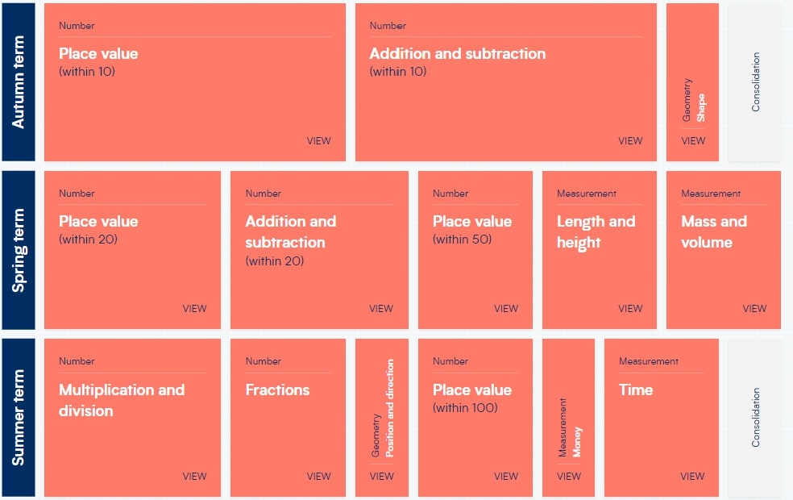
NMR 2025/6
Maths Curriculum
We follow the White Rose Maths scheme.
Children have mental maths sessions during the week using Number Sense.

Slide 14

Timetable

Slide 15
NMR 2025/6
Start and end of the day
Year 1 gate will open and doors to year 1 classes at 8.30am.
Classroom doors will shut at 8.45am ( children to enter via office after this time and will be marked in as late).
At the end of the day, parents to wait in the foundation playground. Teachers will open the doors and call children from the classroom at 3pm.

Slide 16
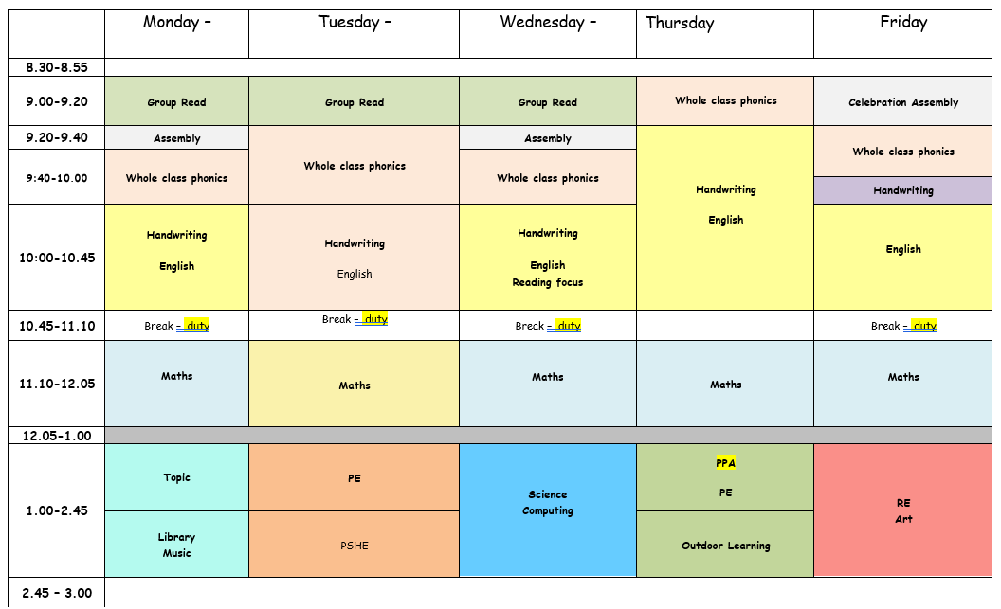
NMR 2025/6
Overview of weekly timetable

Slide 17

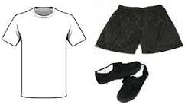

NMR 2025/6
PE/Library/Outdoor Learning – days to be confirmed

Slide 18
NMR 2025/6
Homework Expectations
MyMaths – an activity will be set once a week online
Spelling shed - one activity to be practised at least 3 times a week; children are tested half termly – this are based on phonic words from the previous week.
Reading – to read as much as possible for a minimum of 10 minutes. Parents to write in reading records.
Homework will be set on Fridays and due to be completed by the following Friday.

Slide 19

Equipment

Slide 20
NMR 2025/6
Stationery – This will be provided for each class. ( Pencil cases are not needed in year 1)
  Writing pencils
  Rubbers
  Sharpener
  Whiteboard pens
  Glue sticks
  Colouring pencils
  Ruler
  Scissors

Slide 21
NMR 2025/6
PE Kit – children will come in on both PE days wearing PE kits.
Plain white t-shirt or NMR PE t-shirt
Navy shorts
Trainers
Winter – Navy plain/NMR sweatshirt
Winter – Navy or black tracksuit bottoms
Jewellery should not be worn to school.
If your child wears stud earrings, please provide microtape (in a named box) for placing over the earrings during PE lessons.
LABEL ALL ITEMS OF CLOTHING

Slide 22
NMR 2025/6
Water Bottles and Tuck.
Please ensure your child has a named water bottle in school each day.
Drinking water is available in the classrooms to refill bottles.
If your child would like to bring tuck from home please could this only consist of the following: ​Fruit, vegetables or breadsticks/biscuits /crackers. Please note we are a nut free school.
Please could you make sure that all snack/tuck boxes are clearly named.​
There is school tuck consisting of fruit that is also on offer each day for the children.

Slide 23
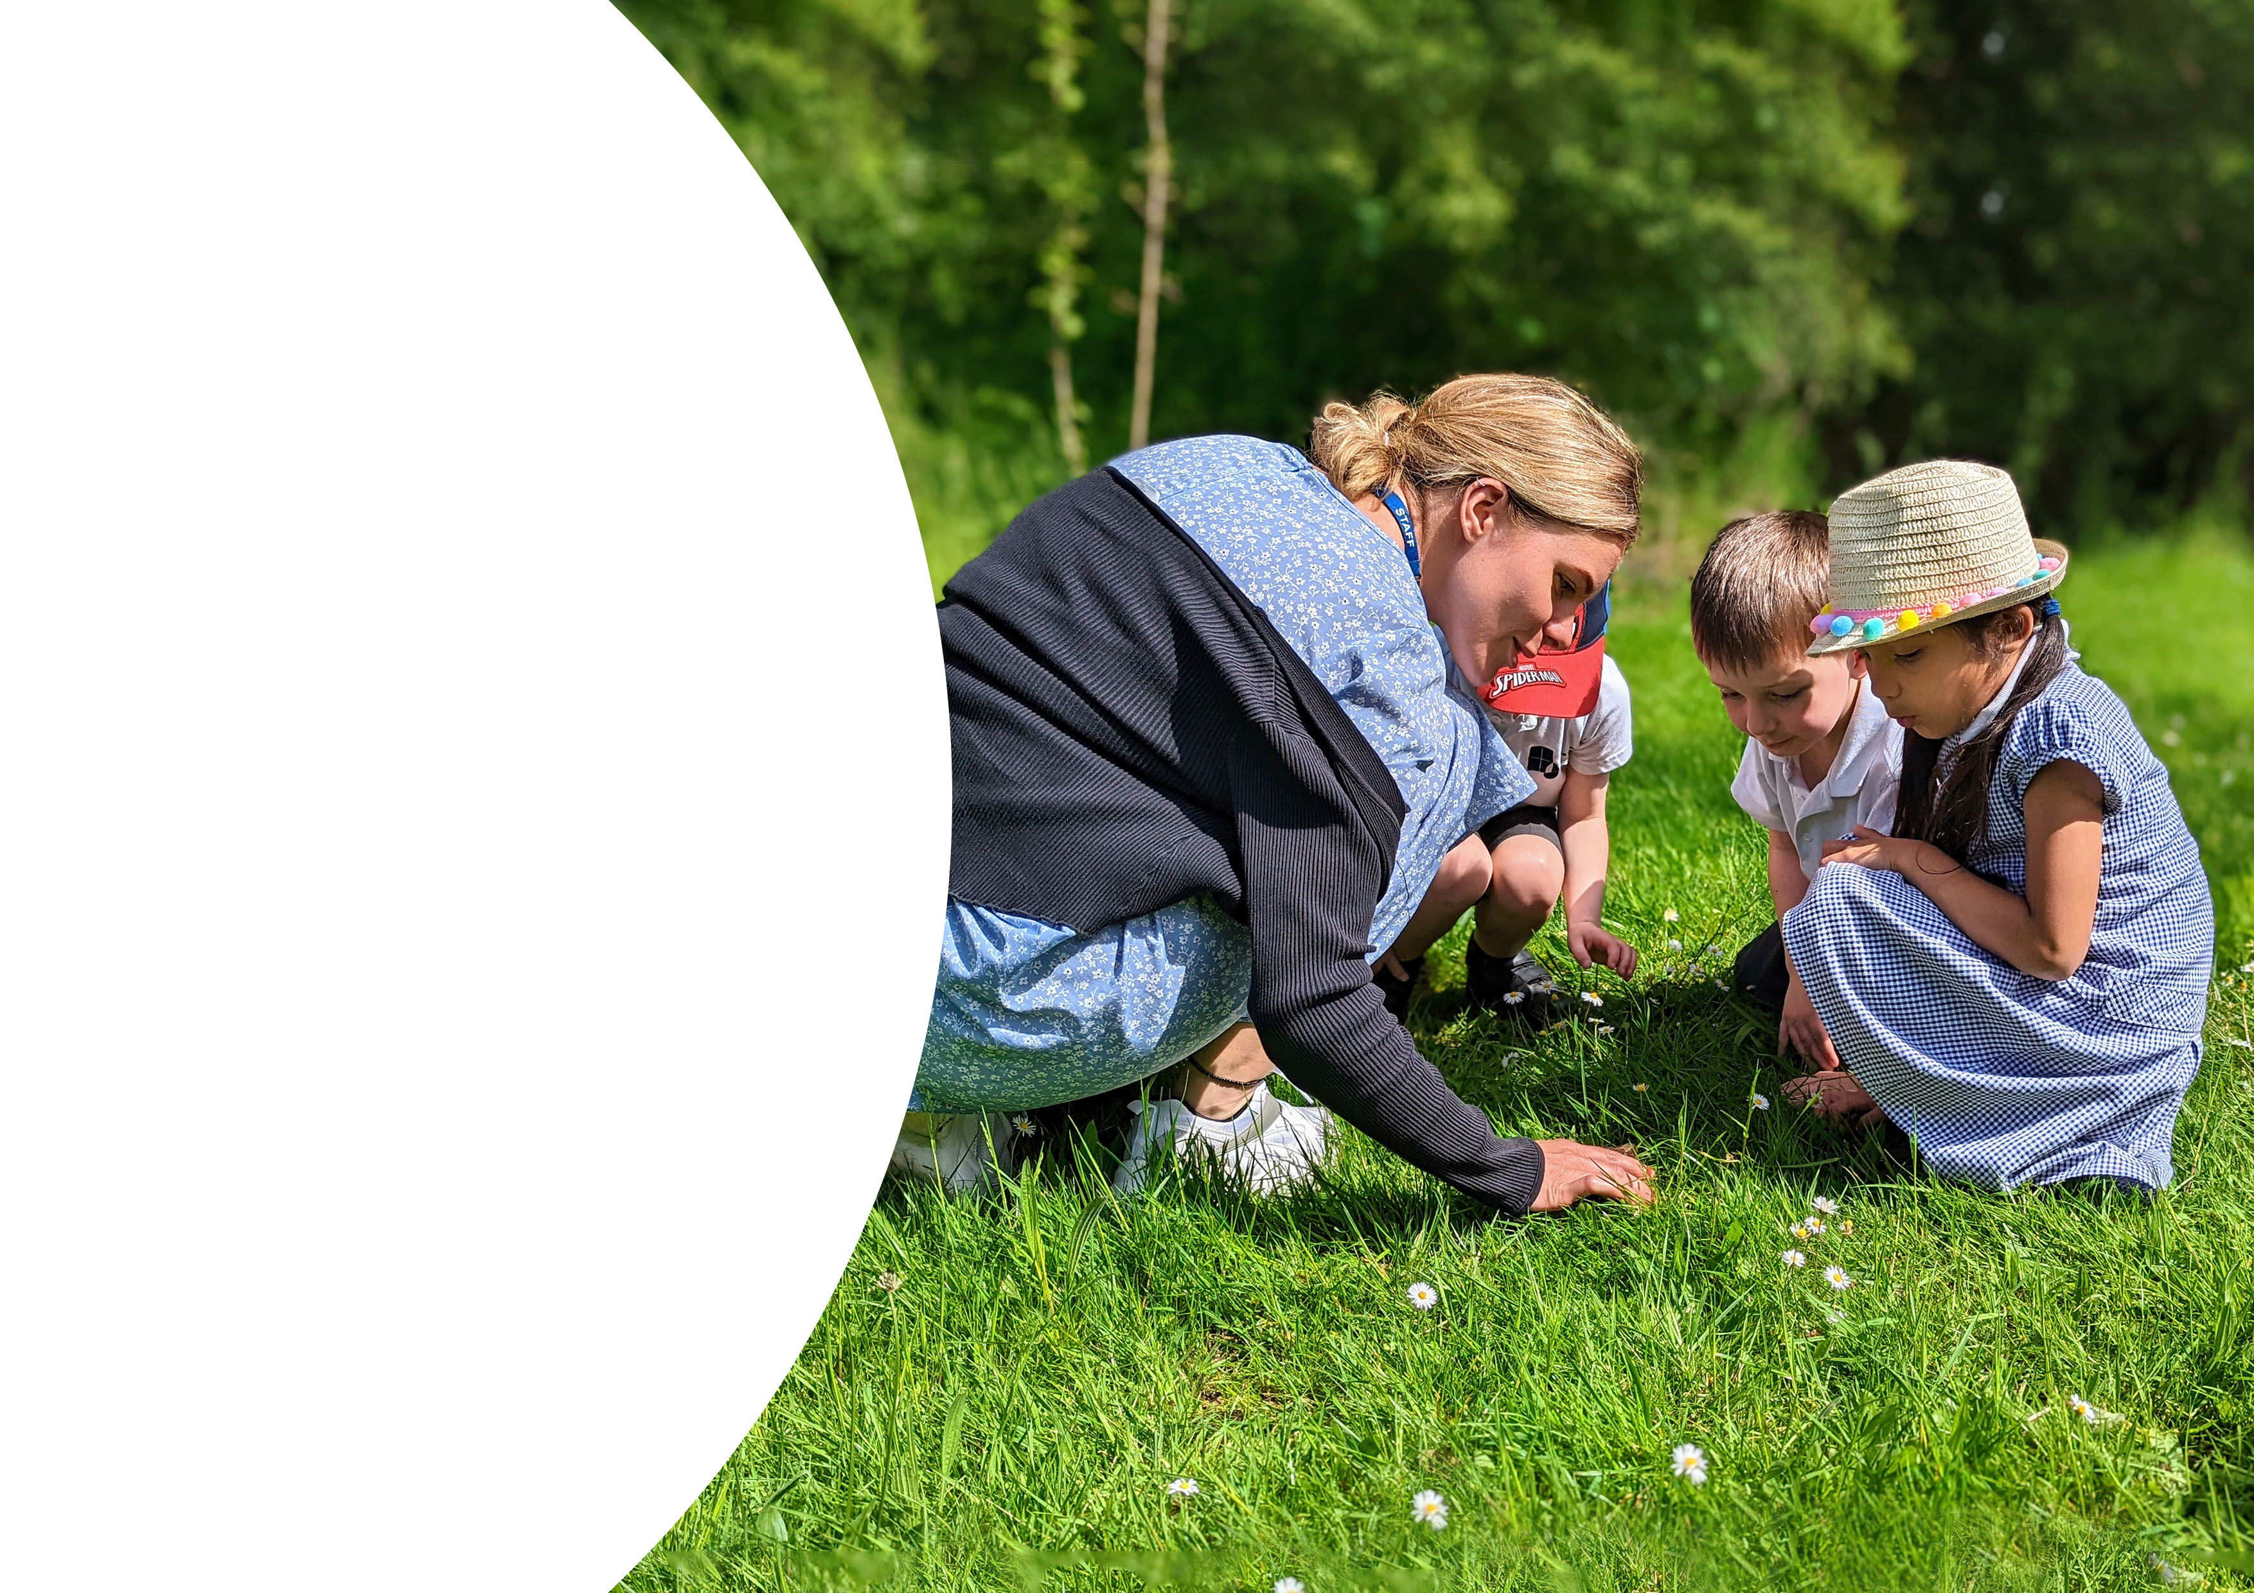
Educational Visits

Slide 24
NMR 2025/6
Dates for the Diary
September
Teddys Bear's Picnic
Walk to the FBC linked to Geography local environment
Berkshire Reptile Man
March.
Showcase of Passports at the Ready to Parents
April.
Legoland Trip linked to Castles and Dragons
January.
Christmas Performance
November
December

Slide 25
NMR 2025/6
Partnership with Parents
In Year 1, we have an open door policy so please let us know if you or your child has any concerns. Feel free to catch us at the gate in the morning, on the playground at the end of the day or alternatively, we are more than happy to arrange an appointment/phone call. ​
Thank you for your ongoing and continued support.

