Slide 1
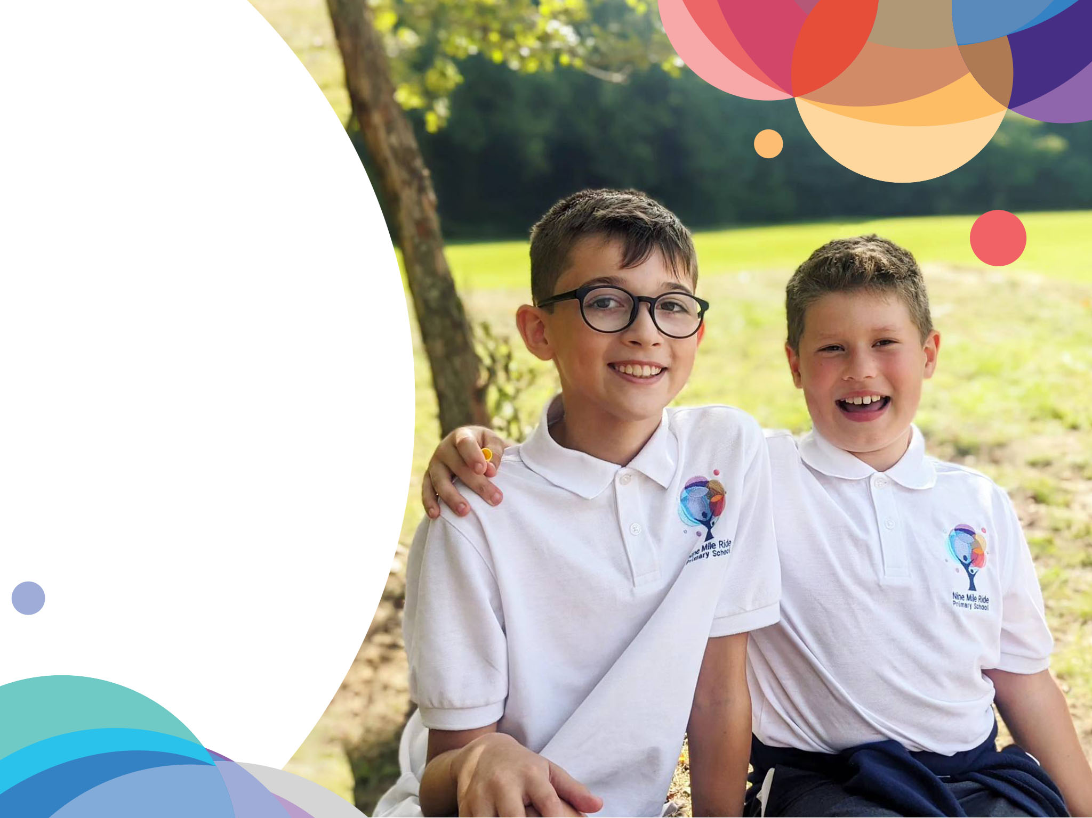


Meet the Teacher
Year 2

Slide 2


NMR 2026/7
Tulip Tree Class
Miss Campbell
Willow Class
Mrs Smith (Mon – Weds)
Mrs Taylor (Thurs – Fri)
Year 2 Teaching Staff Support
Mrs Fenton
Mrs Chavali

Slide 3
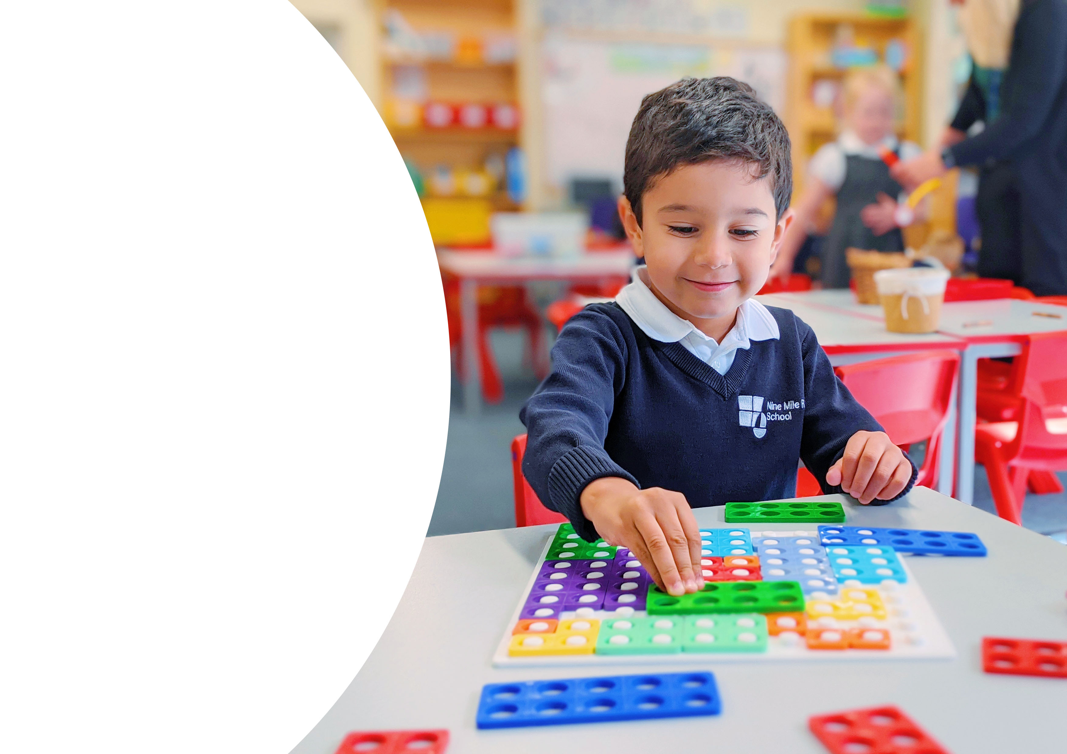

Curriculum

Slide 4

NMR 2026/7
Curriculum content in Year 2
Autumn 2026 | Spring 2027 | Summer 2027
Land Ahoy! | Fire! Fire! | Jurassic Forest

Slide 5

Reading

Slide 6
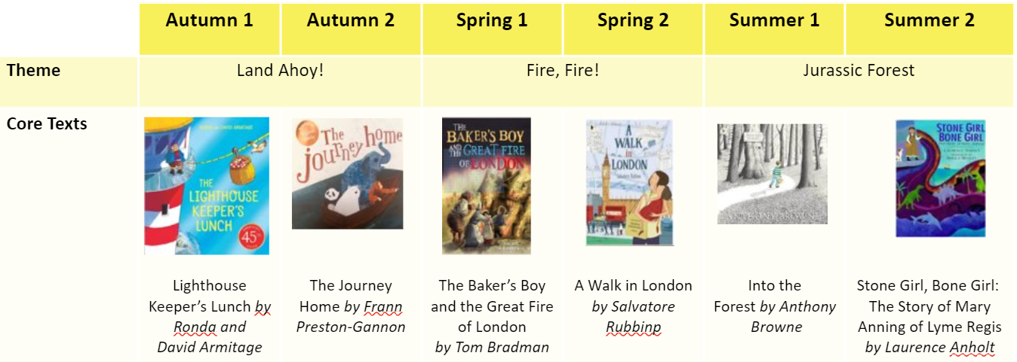
NMR 2026/7
Reading Spine – Class Texts

Slide 7
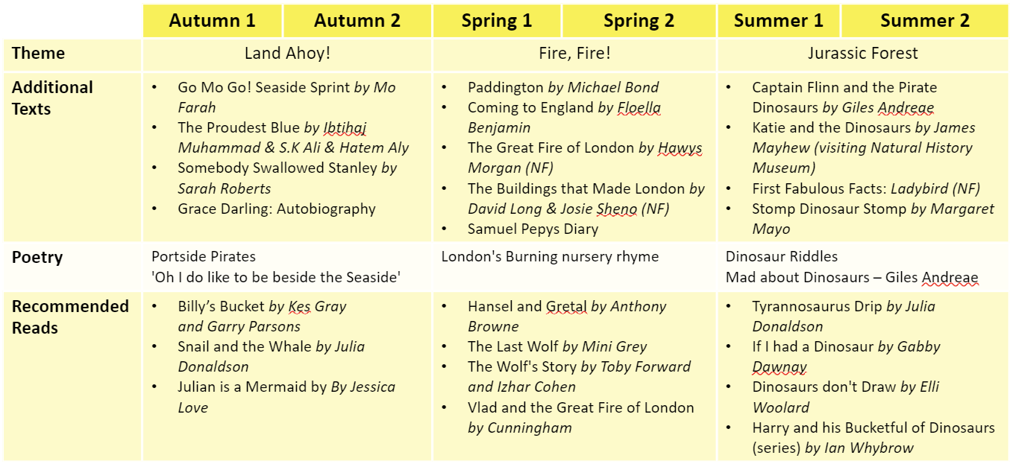
NMR 2026/7
Reading Spine – Recommended Reads

Slide 8
Reading in Year 2
Continuing Little Wandle Letters and Sounds from Rec/Yr1.
3 x group read sessions a week.
(2x adult led and 1x ‘tune in for fluency ‘/independent read)
Continuing to use the phased reading books from Yr1, 7+ books (phase 2-5) and introducing fluency books when your child is ready.
Reading the same book for a week to develop fluency and comprehension.

Slide 9



How do we teach reading in books?
Reading practice sessions:
are timetabled three times a week.
children read the same book three times across each session.
Session 1 – Introduce book and vocab
Session 2 – Reading and comprehension
Session 3 – Tune in for fluency/independent read!
Notes:
Slide purpose:
To introduce decodable readers
Suggested script:
The children read the same book three times in a week.
The first time we work on decoding (sounding out) the words, the second time we work on prosody which is reading with expression – making the book sound more interesting with our ‘storyteller voice’ or our ‘David Attenborough voice’, and the third time we look at comprehension.
We read the books three times at school because we want to develop the fluency. The more they see words the more they begin to read them automatically without having to sound them out.

Slide 10

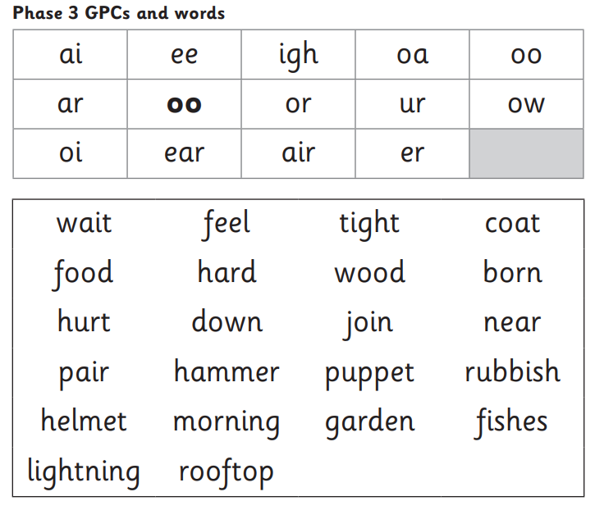


We use assessment to match your child’s reading the right level of book
Notes:
Slide purpose:
To introduce book matching
Suggested script:
We assess your child regularly to check progress.
Any child who needs extra support has Daily Keep-up sessions planned for them.

Slide 11
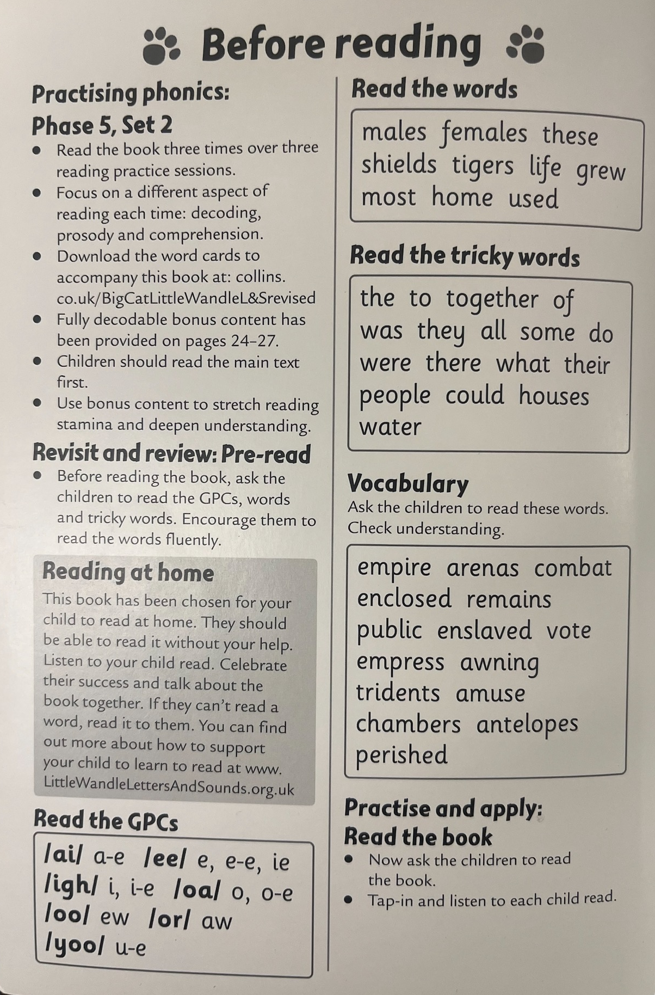
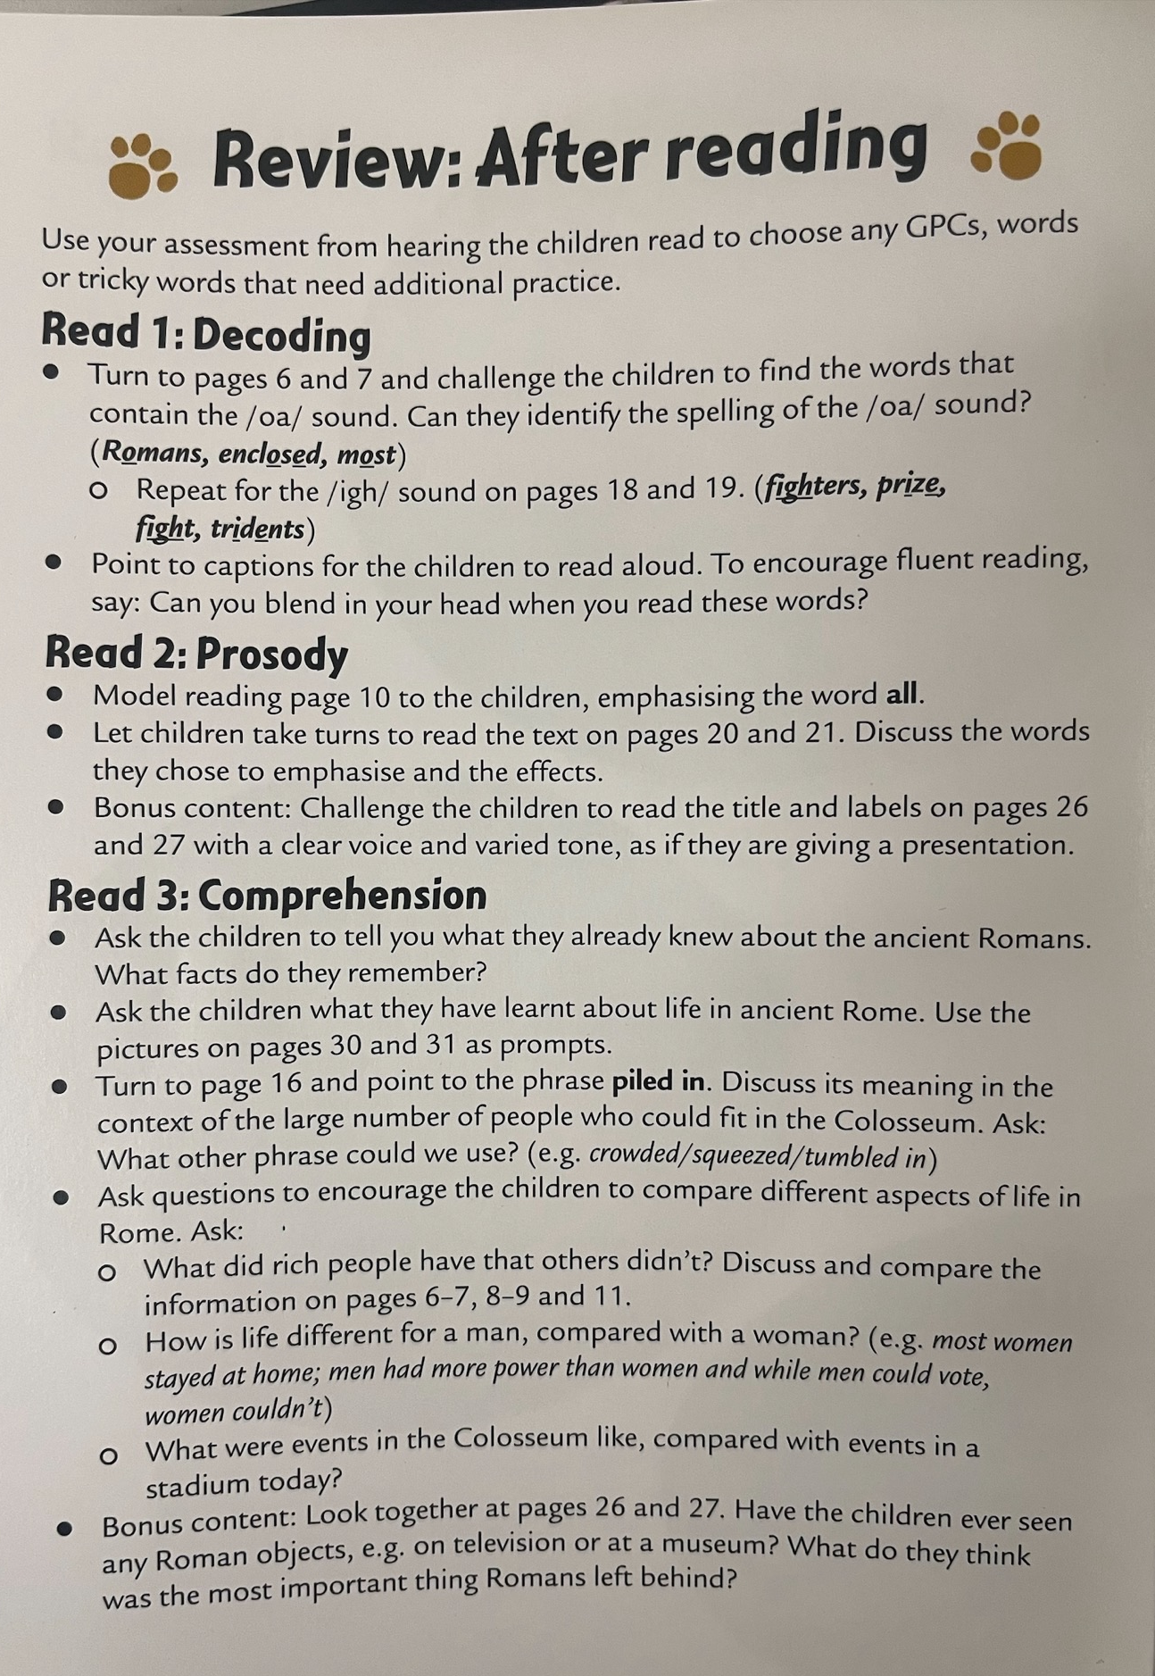

Phase 4 and Phase 5 - 7+ Books
Age appropriate interests (7+) while focusing on words and sounds from Phase 4-5.
Support at the front and back of the book – key words and comprehension support.

Slide 12
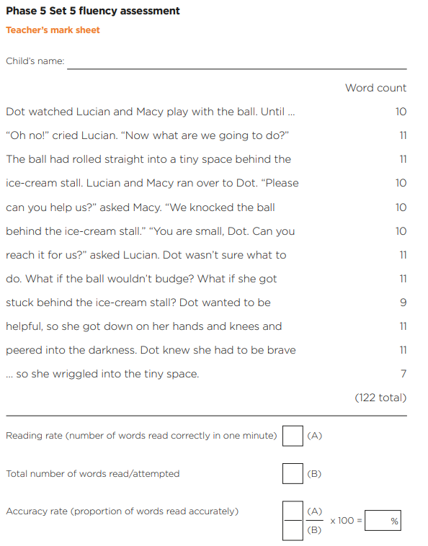
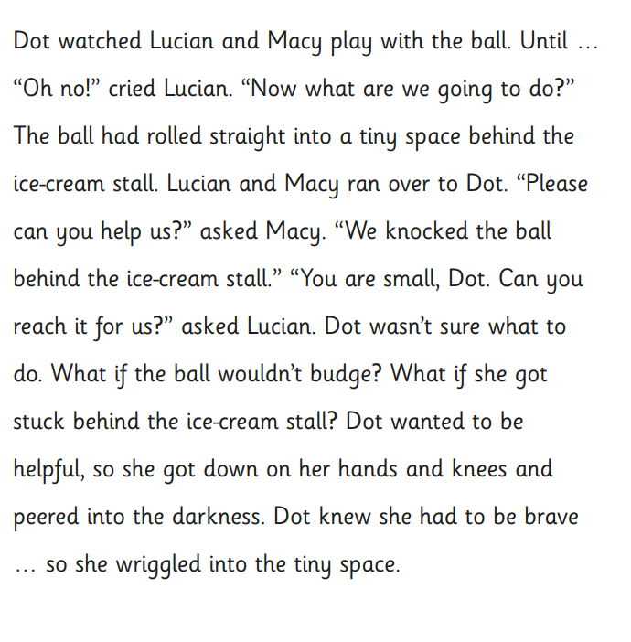
Fluency Assessment

Slide 13
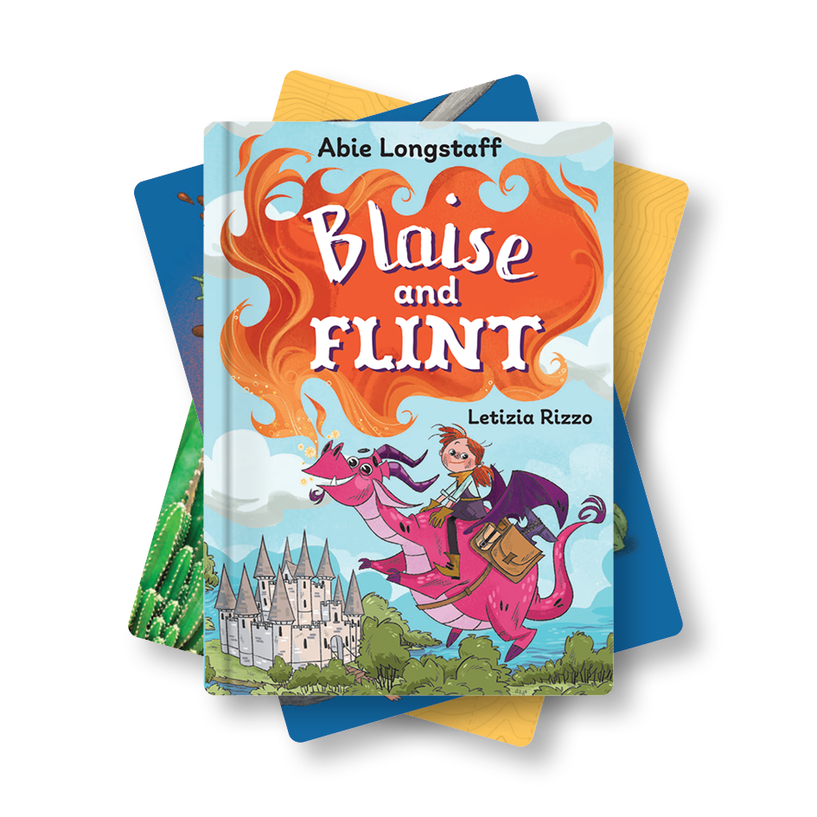
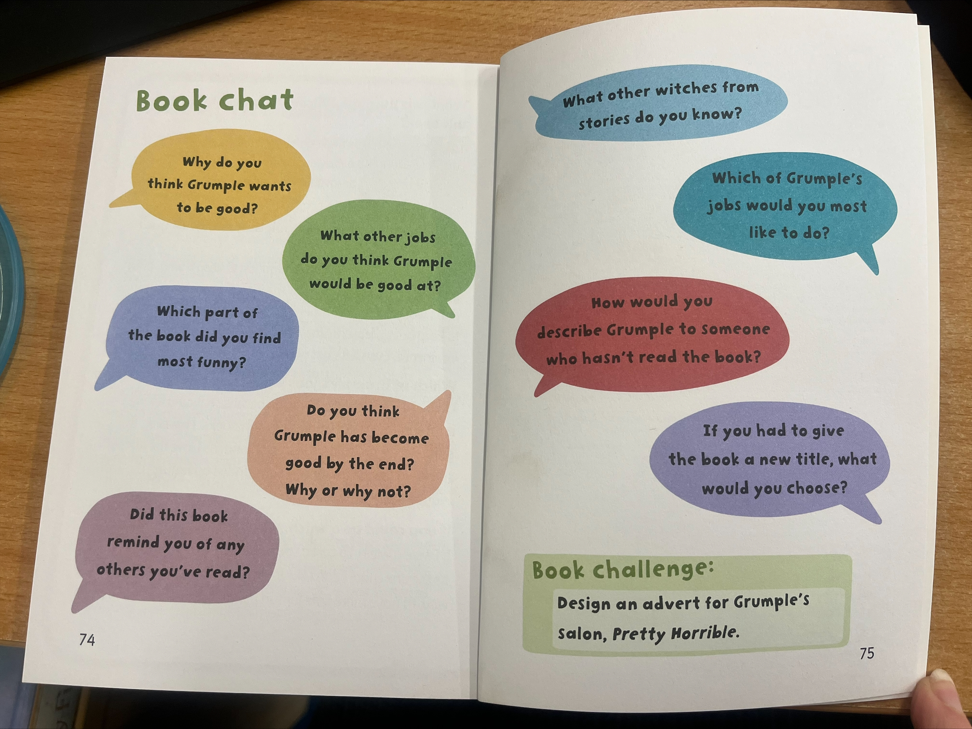

Fluency Books (60-70wpm+ and 90%+ accuracy)
Fluency 1-5 chapter books
Book talk
Challenge activity to extend

Slide 14
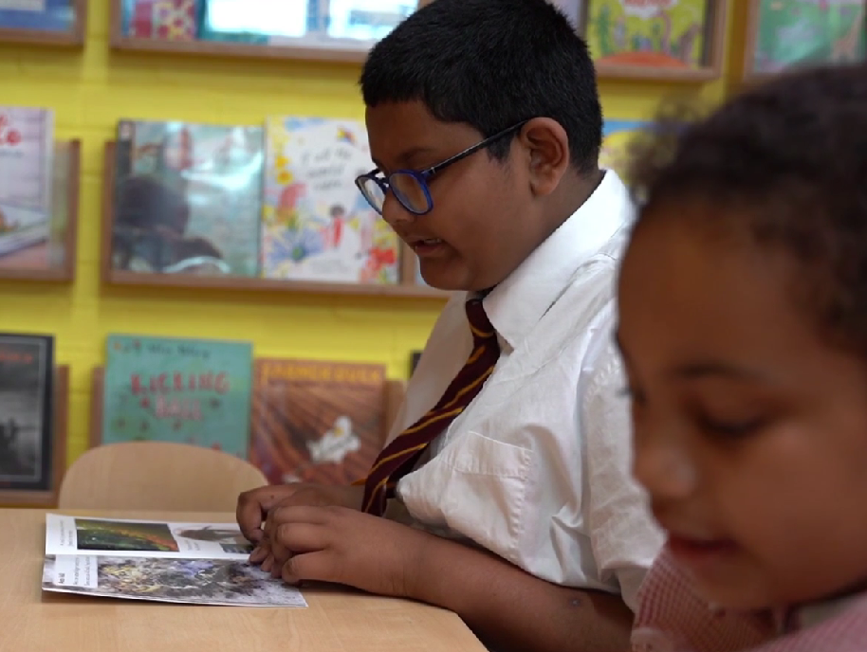
Reading a book at the right level
This means that your child should:
Phase 2-5 - know all the sounds and tricky words in their phonics book well.
Fluency books – be reading 60-70wpm with 90% accuracy.
read many of the words by silent blending (in their head) – their reading will be automatic.
only need to stop and sound out about 5% of the words by the time they bring the book home – but they should be able to do this on their own.
Notes:
Slide purpose:
To provide an overview of book matching.
Suggested script:
Blending in your head means children say the sounds quietly in their heads and then read the whole word out loud. Eventually, this will become automatic and children can read words that they know fluently.

Slide 15

Reading at home

Slide 16





Books to read at home
Notes:
Slide purpose:
To summarise the format of reading at home
Suggested script:
As well as the ‘learning to read’ book that your child will bring home they will also bring home a book for sharing with you.
This book is SO important. This is how we are going to give them the WILL to read.
Please read with your child as often as you can – at least once a day if possible.

Slide 17
Listening to your child read their phonics book
Your child should be able to read their book without your help.
If they can’t read a word, read it to them.
Talk about the book and celebrate their success.
Notes:
Slide purpose:
To provide guidance on reading the decodable reader at home
Suggested script:
Your child will bring home their phonics book, matched to their reading ability, which they will have already read in school.
The purpose of this book is to practise their fluency.
If your child is finding a word hard to read, encourage them to sound and blend.

Slide 18
Key Points
Their book will come home on a Wednesday and your child will keep it until the following Tuesday.
All reading records and books to be in on a Tuesday.
Please write in your child’s reading record when they have read.
Your child won’t have their school reading book/reading record on a Tuesday evening as we will keep this in school ready to hand out their new book on Wednesday.
Children will read their book, matched to their phonics/reading level, in a small group 3 times a week (Mon-Weds).
Please encourage your child to read as little/much of their book per day as they can and re-read for fluency if they finish.
Book talk and challenge at the back of fluency books.
Feel free to read wider too – books at home, from the library etc.

Slide 19
Maths

Slide 20
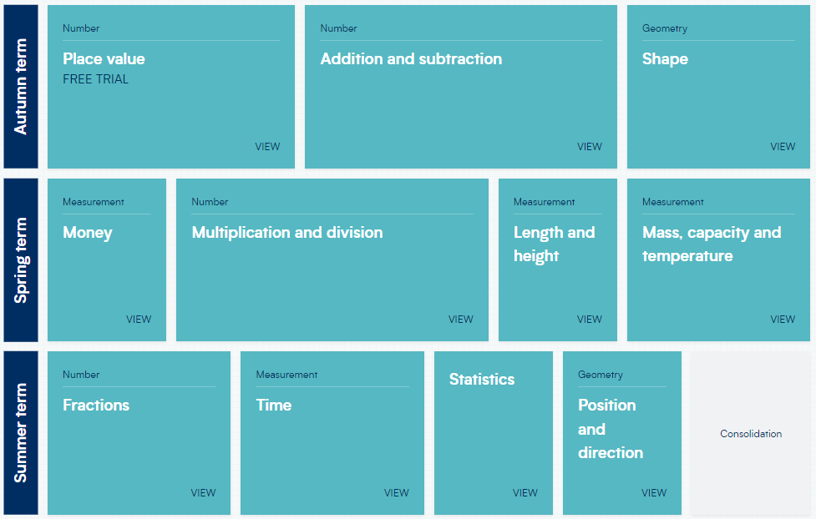
NMR 2026/7
Maths Curriculum
We follow the White Rose Maths scheme.
Children have mental maths sessions during the week using Number Sense.

Slide 21
NMR 2026/7
Maths
Practise times tables – chanting, asking them to recall number facts.
Number bonds.
Practise doubling, halving, sharing using practical resources.
Maths for a purpose: Measuring when cooking, telling the time – how long until?, money – recognising coins and making amounts/change from £5

Slide 22
Writing

Slide 23
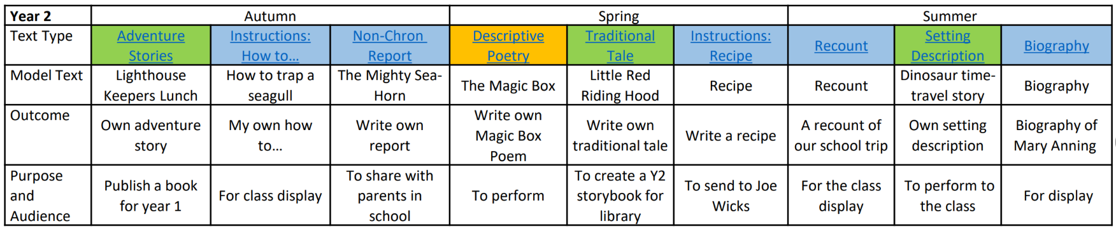
NMR 2026/7
Writing Curriculum
We cover a wide range of genres during the year:

Slide 24
NMR 2026/7
Homework Expectations
MyMaths – an activity will be set once a week.
Spelling Shed - one activity (5 spellings) to be practised at least 3 times a week.
Reading – your child’s reading book as often as you can
Weekly handwriting rule to practise at home.
Homework will be set on Fridays and completed by the following week.
Times Table Rockstars - times tables practise to maintain fluency – 2s, 5s and 10s (Please feel free to access this website to support your child's learning of times tables. This is available as an extra support.)

Slide 25

Equipment

Slide 26
NMR 2026/7
Stationery
Stationery – This will be provided for each class.
(Pencil cases are not needed in year 2)
Writing pencils​
Rubbers​
Sharpener​
Whiteboard pens​
Glue sticks​
Colouring pencils​
Ruler​
Scissors

Slide 27
NMR 2026/7
PE and Outdoor Learning
Our PE days for the year are...TBC!
Please have PE kits in school from Monday to Friday. This allows for flexibility to change days as required.
A spare pair of socks is useful.
Our outdoor learning days are on…
TBC!

Slide 28
NMR 2026/7
PE Kit
Plain white t-shirt or NMR PE t-shirt
Navy shorts
Trainers
Winter – Navy plain sweatshirt
Winter – Navy or black tracksuit bottoms
Jewellery should not be worn to school (unless for religious purposes).
If your child wears stud earrings, please provide microtape (in a named box) for placing over the earrings during PE lessons.

Slide 29
NMR 2026/7
Water Bottles
Please ensure your child has a named water bottle in school each day.
Drinking water is available in the classrooms to refill bottles. Please don't worry if your child forgets their water bottle as we have cups available and will always make sure they have a drink.
If your child would like to bring tuck from home, please could this only consist of the following: Fruit, vegetables or breadsticks/plain crackers. Please note we are a nut free school.
Please could you make sure that all snack/tuck boxes are clearly named.
There is school tuck consisting of fruit that is also on offer each day for the children. Please don't worry if your child forgets tuck.
Tuck

Slide 30
NMR 2026/7
Start and End of the Day
The children will enter the main playground in the morning and can head round to class from 8.30am. ​During the first week, members of the Year 2 team will be around to support and see the children to the classrooms.
The main gates will shut at 8.45am (children will enter via the office after this time). ​
At the end of the day, parents will wait on the main playground to collect your child at 3pm.

Slide 31
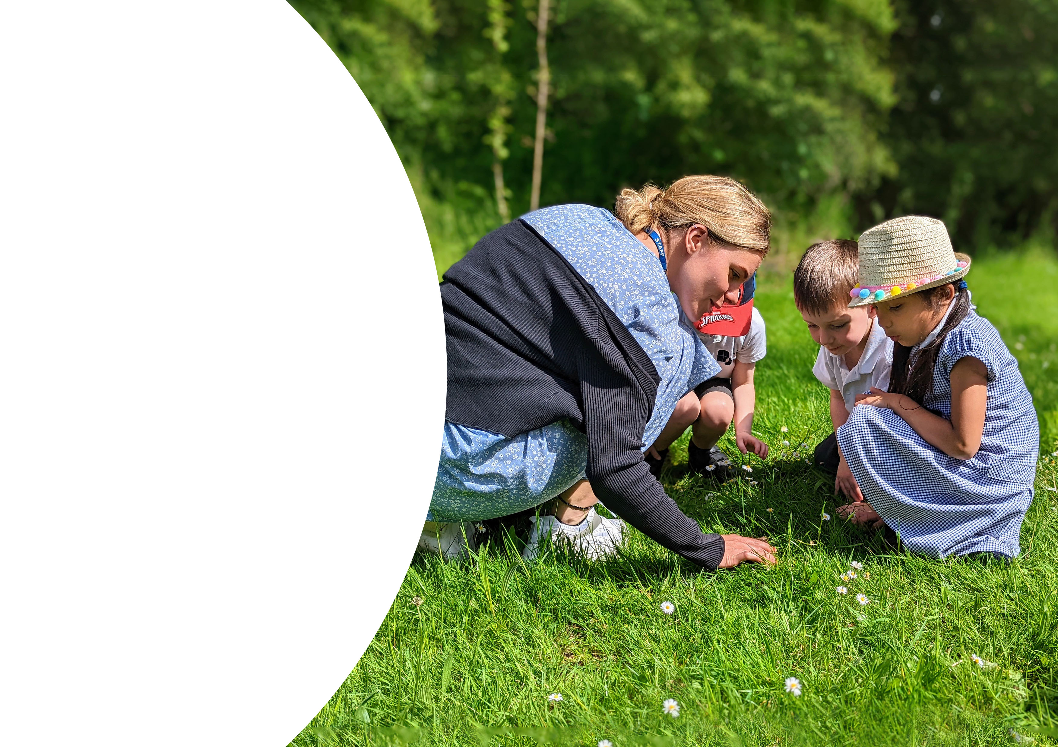
Educational Visits

Slide 32
NMR 2026/7
Dates for the Diary
These are subject to change, and they are not confirmed.
Summer Term
Wellington Country Park linked to Jurassic Forest topic
Christmas Performance
Spring Term
Great Fire of London Lego workshop (NMR)
Autumn Term

Slide 33
NMR 2026/7
Parent Partnership
In Year 2, we have an open-door policy so please let us know if you or your child has any concerns.
Feel free to catch us at the gate in the morning, on the playground at the end of the day or alternatively, we are more than happy to arrange an appointment/phone call.
Thank you for your ongoing and continued support.

