Slide 1



Meet the Teacher Year 3

Slide 2


NMR 2026/7
The Year 3 Team
Elm Class
Mrs Mahony
Maple Class
Mrs Porter
Year 3 Teaching Staff Support
Mrs Davies
Mrs MacDonald

Slide 3
NMR 2026/7
Curriculum Content in Year 3
Autumn 2026 | Spring 2027 | Summer 2027
Gunpowder, Treason and Plot | Tomb Raiders | Rainforest Rangers

Slide 4

NMR 2026/7
Reading Curriculum
Children will have a weekly library slot. This date will be confirmed in September.
They will also have access to the class bookshelf​.
Every day in school the children will be silently reading for 10 minutes as part of DEAR time.
At Year 3, the focus is on the development of reading comprehension skills (VIPERS).
Reading Records
Children must record the number of pages and date in their reading records.
Please sign the reading records ready for Monday when the reading records are handed in and checked.

Slide 5

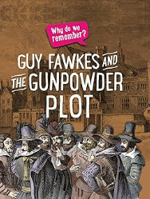
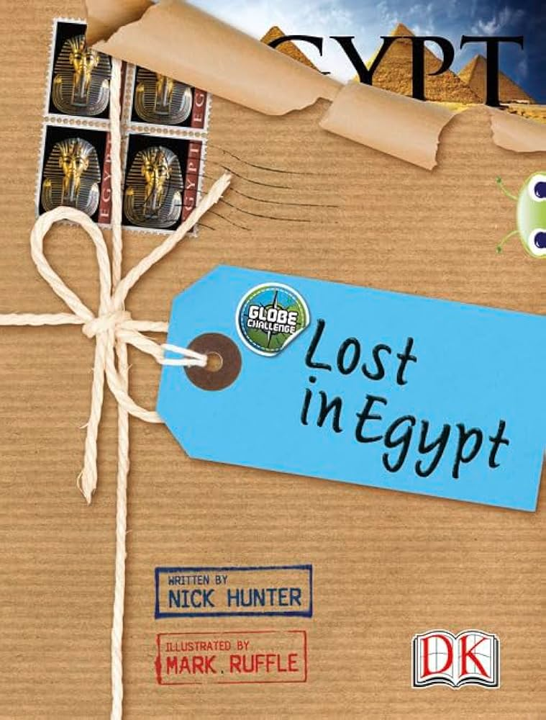



NMR 2026/7
Core Texts in Year 3
 | Autumn 1 | Autumn 2 | Spring 1 | Spring 2 | Summer 1 | Summer 2
Theme | Gunpowder, Treason and Plot |  | Tomb Raiders |  | Rainforest Rangers
Core Texts | The Owl who Was Afraid of The Dark (Chapter Book) by Jill Tomlinson | Guy Fawkes and the Gunpowder Plot by Izzi Howell | There's a Pharaoh in our Bath by Jeremy Strong | Lost in Egypt by Nick Hunt | My First Encyclopaedia of the Rainforest: A Great Big Book of Amazing Animals and Plants Richard McGinlay | The Secret Explorers and the Rainforest Rangers By SJ King
Please purchase a copy of these texts for the upcoming terms.

Slide 6
NMR 2026/7
Additional Texts in Year 3
 | Autumn 1 | Autumn 2 | Spring 1 | Spring 2 | Summer 1 | Summer 2
Theme | Fireworks |  | Tomb Raiders |  | Rainforest Rangers
Additional Texts - Fiction | Black Powder by Ally Sherrick Prince of Fire by Jatinder Verma |  | The Boy Who Stole The Pharaoh's Lunch by Karen McCrombie and Anneli Bray Marcy and the Riddle of the Sphinx by Joe Todd Stanton Cinderella of the Nile by Beverley Naidoo |  | The Secret Explorers and the Rainforest Rangers By SJ King There's a Rang-Tan In My Bedroom by James Sellick One Day on our Blue Planet: In the Rainforest By Ella Bailey Over and Under the Rainforest By Kate Messner
Additional Texts – Non-Fiction | The Gunpowder Plot by Rob Lloyd Jones Celebrate the World: Diwali by Hannah Eliot and Archana Sreenivasan |  | Egyptology: Search for the Tomb of Osiris By Dugald Steer Egypt Magnified By David Long and Harry Bloom Tutankhamun’s Treasure by David Long |  | The Rainforest Book By Charlotte Milner Let’s Save the Amazon By Catherine Barr The Where on Earth Book of Rainforests By Susie Brooks
Poetry | Zim Zam Zoo! by James Carter (Firework Poem) |  | The Puffin Book of Utterly Brilliant Poetry Edited by Brian Patten |  | The Rainforest and Other Poems- By Debbie Croft
Recommended Reads | Flat Stanley: The Egyptian Grave Robbery by Sara Pennypacker The Iron Man by Ted Hughes Charlotte's Web by E. B White and Garth Williams |  | What would you be in Ancient Egypt? - By David Owen The Ancient Egyptian Sleepover by Stephen Davies |  | Tree of Wonder By Kate Messner 100 Questions About The Amazon Rainforest By Simon Abbott Leonora Bolt By Lucy Brandt & Gladys Jose

Slide 7
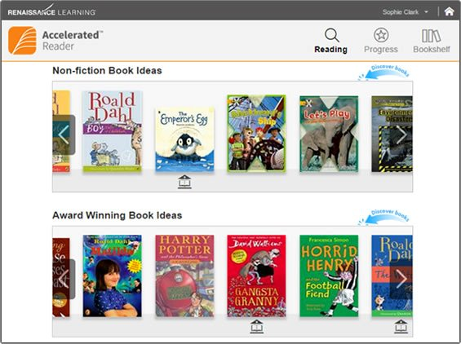
NMR 2026/7
Accelerated Reader
Children choose books from their ZPD numbers.
Once they have read the book-in school your child will take the AR Quiz.
100% This book was comfortable for you. Try a book 1 or 2 levels higher up within your ZPD range.
90% This book was perfect for you. Try a book 1 level higher.
80% This book was a little difficult for you. Try a book of the same level or 1 level lower.
70% This book was challenging for you. Try a book 1 level lower.
60% This book was too challenging. Try a book 2 levels lower.
Below 60% You did not pass this quiz. Try a book towards the start of your ZPD level.

Slide 8
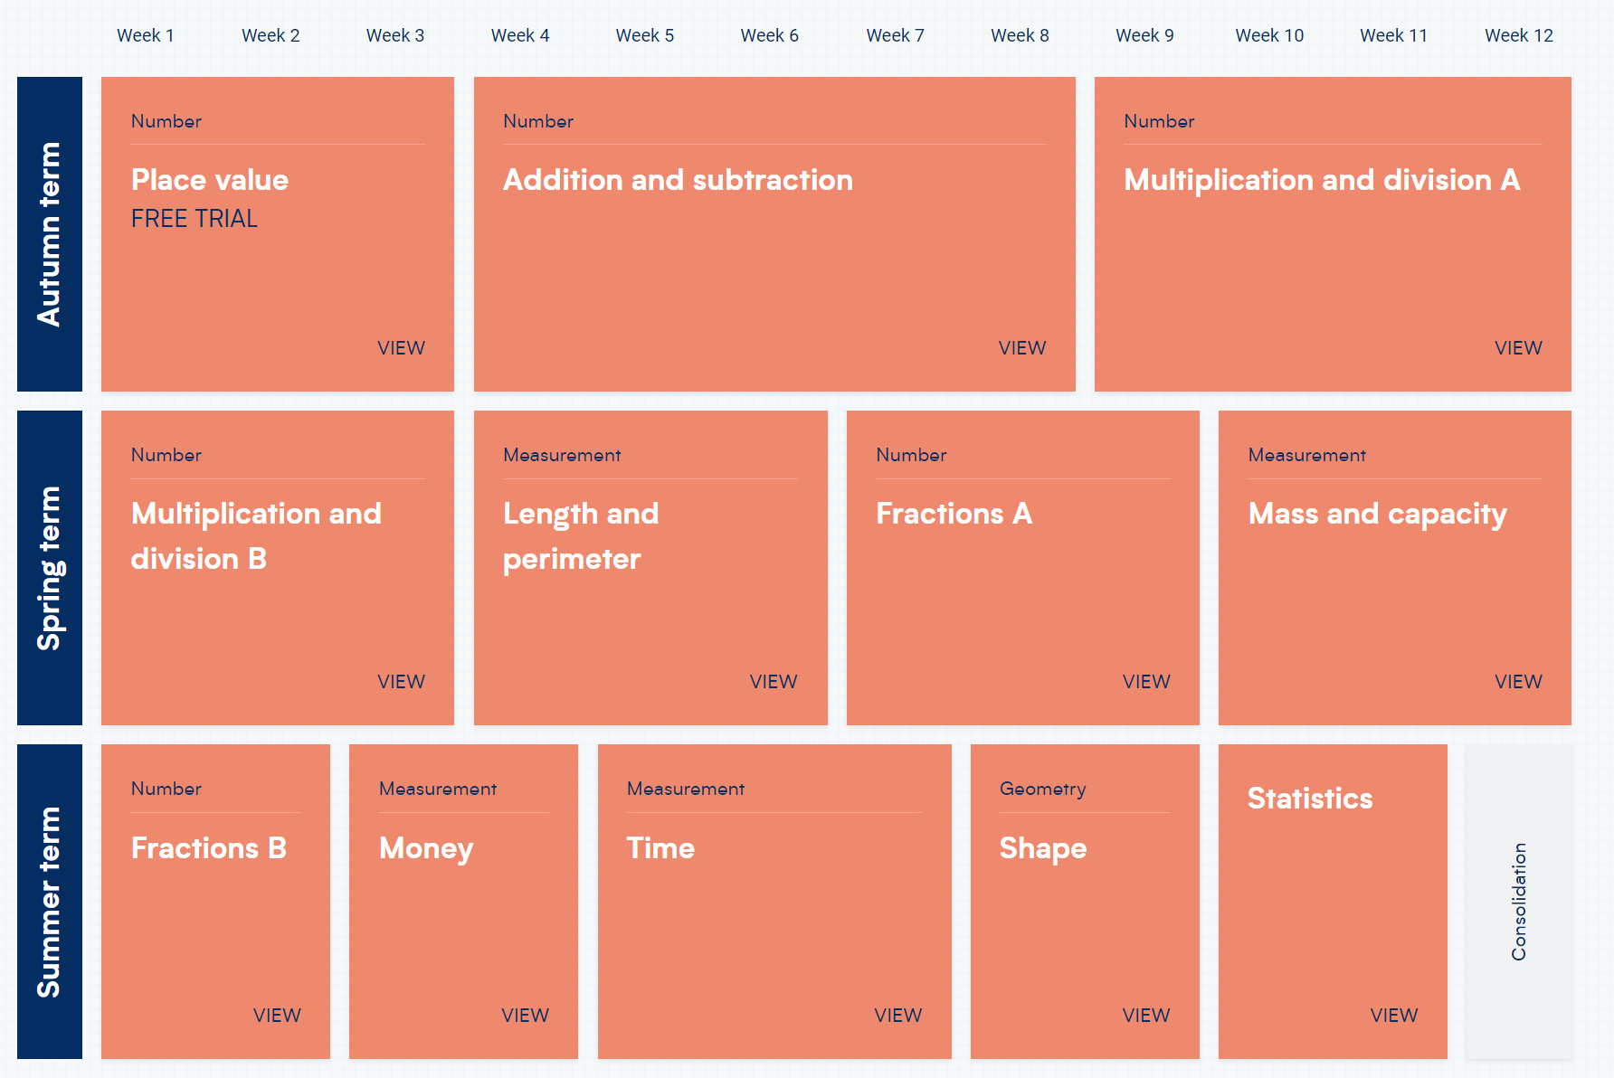
NMR 2026/7
Maths Curriculum
Children are taught Maths in their class groups using a mastery approach. ​
We use the White Rose Maths scheme.
Children have mental maths sessions following the Number Sense Programme.

Slide 9
NMR 2026/7
Writing Curriculum
Children will cover a range of genres...
Year 3 | Autumn |  |  | Spring |  |  | Summer
Text Type | Story Ending | Formal Letter | Descriptive Poetry | Information Text | Mystery Story | Diary Entry | Non- chronological report | Biography | Poetry
Model Text | The Owl who was Afraid of The Dark | Persuasive letter to the Headteacher | Shape poems | Encyclopedia | Grand Pharaoh Terrace | Howard Carter’s Diary Entry | Sloths | The Life of David Attenborough | Rumble in the Jungle
Outcome | Story Ending | Persuasive letter | Own poem | Own fact file page | Mystery story | Diary entry as an archaeologist | Non-chronological report for a new species of animal | Biography of own naturalist | Write own poems about a rainforest animal
Purpose and Audience | To be shared with lower year group | To write a letter to the Headteacher about an event | To be written in a Christmas Card to a family member | For a Y3 Ancient Egypt encyclopedia | To turn into a class book | To publish on tea-stained paper | Share and pair with upper KS2 class | To be displayed in the classroom | To publish for the book corner

Slide 10
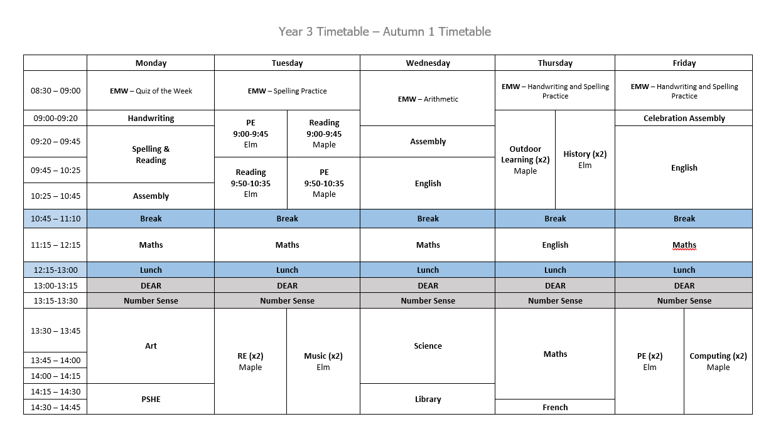
NMR 2026/7
Example Timetable

Slide 11
NMR 2026/7
Homework Expectations
​
Maths - MyMaths – 1 activity to be practised at least 3 times a week.
Mental Maths practice - Times Table Rockstars - times tables practise to maintain fluency using.
Spellings - Spelling Shed - 1 activity to be practiced at least 3 times a week. These will be tested weekly.
Reading - Reading Records – children are expected to read for at least 10 minutes 3-5 times a week.
Spellings will be set on a Monday.
Maths will be set on a Friday.

Slide 12
NMR 2026/7
Year 3 Expectations
Taking responsibility for homework and packing bag ready for school. ​
Knowing PE day, returning reading book, completing quizzes, returning library books etc. ​
Lunchboxes, water bottles and snack boxes.

Slide 13


NNMR 2026/7
PE
  Please have PE kits in school from Monday to Friday. This allows for flexibility to change days as required.
  We will confirm with you in September which days we will do PE on.

Slide 14
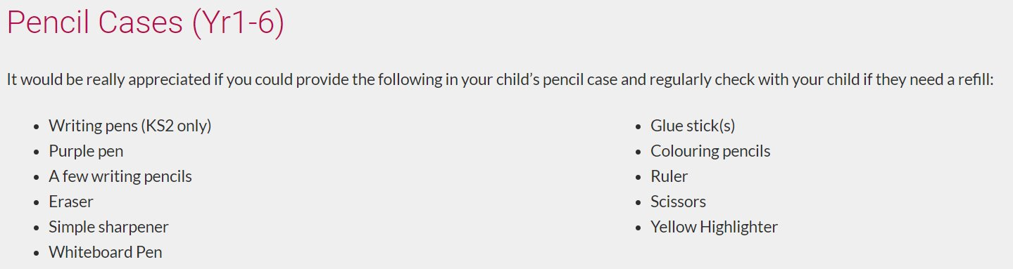
NMR 2026/7
Equipment Required in Year 3
Please ensure your child has a named water bottle in school each day.​
Drinking water is available in the classrooms to refill bottles.

Slide 15
NMR 2026/7
Upcoming Events
Portals from the Past Egyptian Workshop:
Date TBC
The Living Rainforest- Summer Term
Date TBC

Slide 16

NMR 2026/7
Parent Partnership
In Year 3, we have an open-door policy so please let us know if you or your child has any concerns. Feel free to catch us at the gate in the morning, on the playground at the end of the day or alternatively, we are more than happy to arrange an appointment/phone call.
Thank you for your ongoing and continued support.

