Slide 1



Meet the Teacher Year 5

Slide 2
Who is who?
Chestnut Class
Miss Rogers
Beech Class
Mrs Hicks
Year 5 teaching support staff
Mrs Tunstall
Miss Burton
Mrs Lee
Ms Kmiecik

Slide 3


NMR 2025/26
Curriculum content in Year 5
 | Groovy Greeks Ancient Greece | I’m an evacuee – get me out of here! WW2
Autumn 2026 | Spring 2027 | Summer 2027
To Infinity and Beyond!
Space

Slide 4
NMR 2025/26
Reading Curriculum
Children will have a weekly library slot.
They will also have access to the class bookshelf​.
Every day after lunchtime in school the children will be silently reading for 10 minutes as part of DEAR time.
Reading Records
Children are expected to read for at least 10 minutes 5 times a week.
Children must record the number of pages and date in their reading records.
Please sign these reading records ready for Friday where they will be checked.

Slide 5
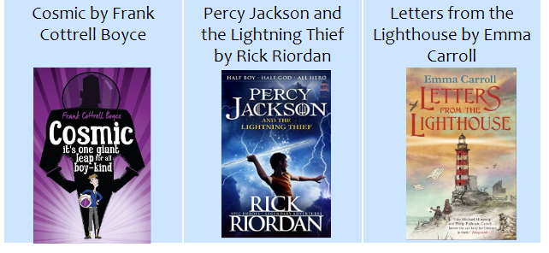
Class Reading Texts

Slide 6
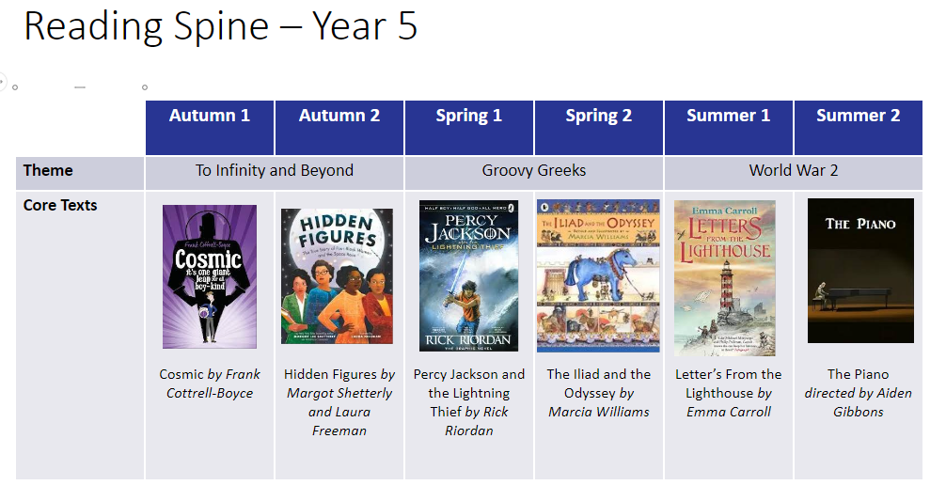

Slide 7
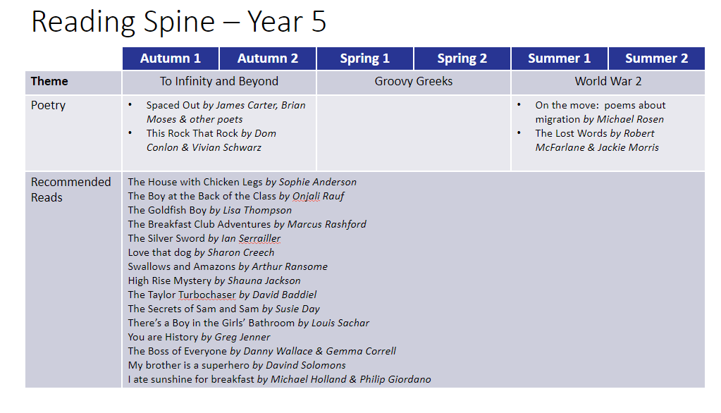

Slide 8
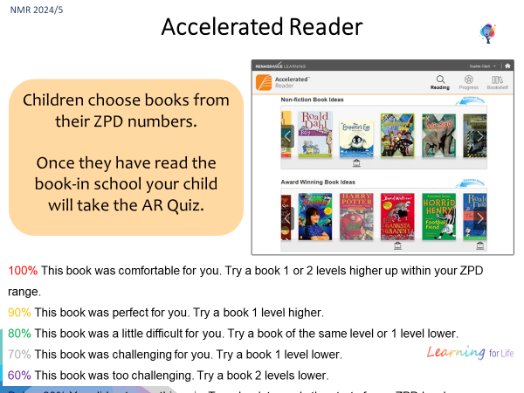

Slide 9
Maths curriculum
Children are taught Maths in their class groups using a mastery approach. ​
We use a White Rose Maths scheme.

Slide 10
Homework expectations
•Maths - Mymaths – 1 Activity a week.
•Mental Maths practice - Times Table Rockstars - times tables practice to maintain fluency
•Spellings - Spellingshed - 1 Activity to be practised 3 times a week.
•Spellings will be added and tested weekly.
•Reading- Reading Records – children are expected to read for at least 10 minutes 5 times a week.
•When children have finished a book, they should complete the quiz on Accelerated Reader.
•Homework will be set on Fridays and due to be completed by the following Friday.

Slide 11
Year 5 expectations
•Taking responsibility for homework and packing bag ready for school.
•Knowing PE day, returning reading book, completing quizzes, returning library books etc.
•Lunchboxes, water bottles and snack boxes.

Slide 12
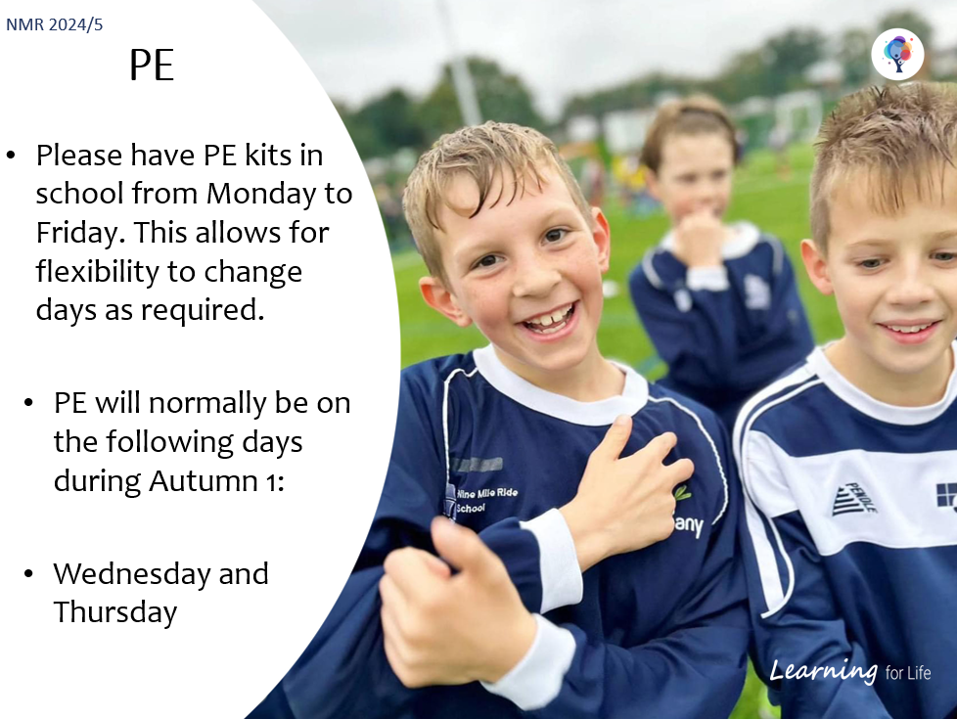
Tbc

Slide 13
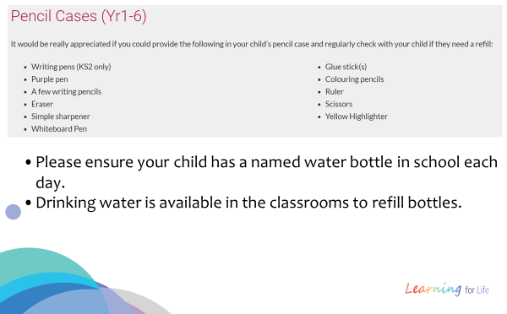
Equipment required in year 5

Slide 14
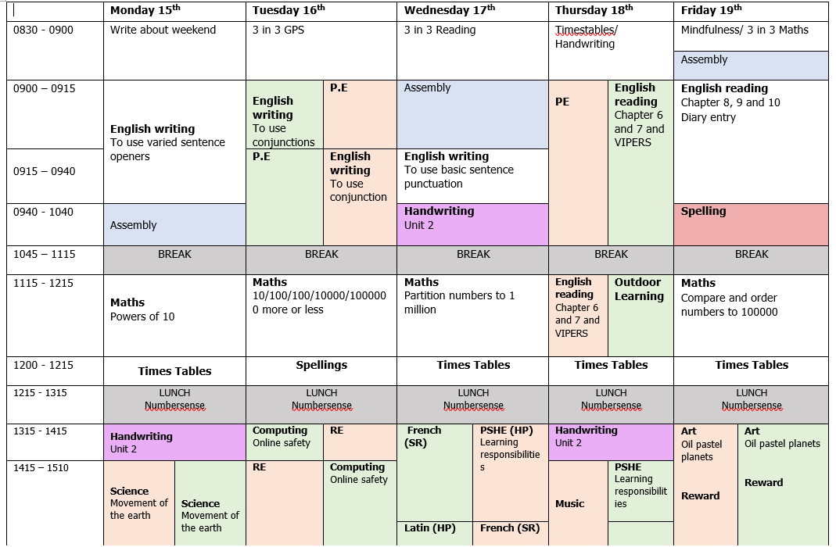
Example timetable
Autumn term:
Planetarium
Summer term:
Trip to the Gurdwara in Slough
Swimming lessons
Drama sessions every term.

Slide 15
Year 5 expectations
Reminder – payments for Osmington Bay and swimming will be due
Any questions?

