Slide 1



Meet the Teacher Year 6

Slide 2


Who is who?
Lime Class
Miss Guinn
Hawthorn Class
Miss Barnby
Year 6 Teaching Staff Support
Mrs Fearon
Mrs Torr

Slide 3
Curriculum content in Year 6
Autumn 2026 | Spring 2027 | Summer 2027
Vile Victorians | Lost Civilisations | To be or not to be

Slide 4



Class Reading Texts
Autumn 2026 | Spring 2027 | Summer 2027
Street Child by Berlie Doherty | Holes by Louis Sachar | Cloud Busting by Malorie Blackman
Try to encourage your child to read for pleasure.
You could take it in turns to read pages, expose them to a variety of fiction and non-fiction books. Additionally, you could show your child how we read for a purpose: signs, recipes and lists.

Slide 5

Reading Curriculum
Children will have a weekly library slot.
They will also have access to the class bookshelf​.
Every day after lunchtime in school the children will be silently reading for 10 minutes as part of DEAR time.
At Year 6, the focus is on the development of VIPERS skills. of reading comprehension skills (VIPERS).
Reading Records
Children are expected to read for 10 minutes 5 times a week.
Children must record the number of pages and date in their reading records.
Please sign these reading records ready for Monday where they will be checked by the class teachers.

Slide 6
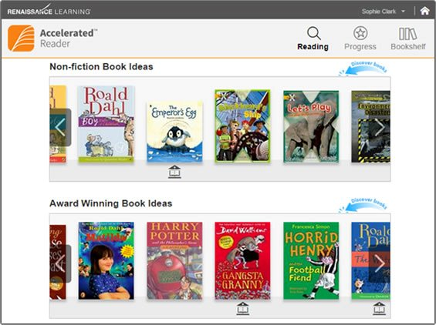
Accelerated Reader
Children choose books from their ZPD numbers.
Once they have read the book-in school your child will take the AR Quiz.
100% This book was comfortable for you. Try a book 1 or 2 levels higher up within your ZPD range.
90% This book was perfect for you. Try a book 1 level higher.
80% This book was a little difficult for you. Try a book of the same level or 1 level lower.
70% This book was challenging for you. Try a book 1 level lower.
60% This book was too challenging. Try a book 2 levels lower.
Below 60% You did not pass this quiz. Try a book towards the start of your ZPD level.

Slide 7



Reading Curriculum Spine
 | Autumn 1 | Autumn 2 | Spring 1 | Spring 2 | Summer 1 | Summer 2
Theme | Vile Victorians |  | Lost Civilisations |  | To Be Or Not To Be
Recommended Reads | Amari & the Night Brothers by B B Alston The Phantom Tollbooth by Norton Juster Tom’s Midnight Garden by Philippa Pearce Nevermoor: the trials of Morrigan Crowe by Jessica Townsend Malamander by Thomas Taylor Skandar and the Unicorn Thief by A F Steadman Artemis Fowl by Eoin Colfer Skullduggery Pleasant by Derek Landy The Explorer by Katherine Rundell Head Kid by David Baddiel Funky Chickens by Benjamin Zephaniah Kay’s Anatomy by Adam Kay Onyeka and the Academy of the Sun by Tola Okugwu Can you see me? by Libby Scott and Rebecca Westcott The Kite Rider by Geraldine McCaughrean The Lion, the Witch and the Wardrobe by CS Lewis The Boy with the Butterfly Mind by Victoria Williamson The Boy who made everyone laugh by Helen Rutter

Slide 8
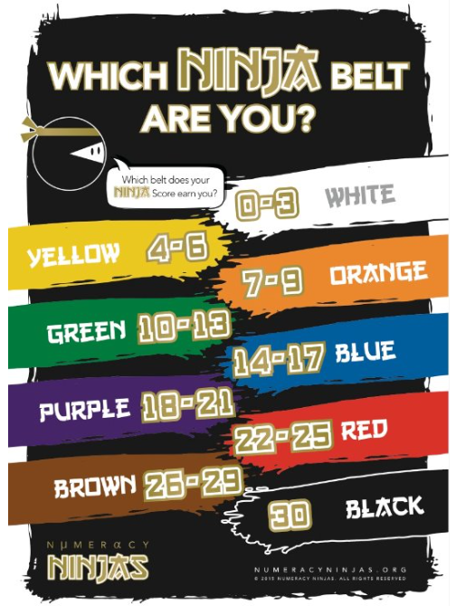
Maths Curriculum
Children are taught Maths in their class groups using a mastery approach. ​
We use a White Rose Maths scheme.
Children have daily mental maths sessions including times tables (up to 12 x) called Ninja Maths.

Slide 9
Writing Curriculum
Children will write both fiction and non-fiction texts throughout the year whilst carefully considering the audience and the purpose.
We structure the writing lessons as follows:
  COLD TASK (write independently).
  Identify and explore features over a series of lessons.
  Hot Task (write independently with support from series of lessons).
In year 6, we use PIXL Writing indicators to mark and assess the children's independent writing. This forms the evidence for their end of year grade.

Slide 10
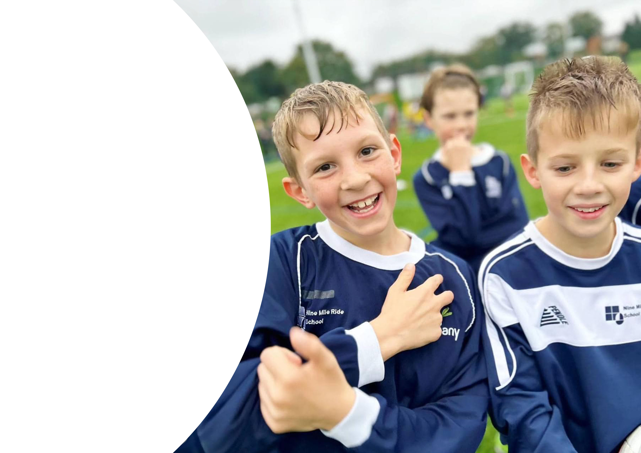

PE
  Please have PE kits in school from Monday to Friday. This allows for flexibility to change days as required.
  We will confirm with you in September which days we will do PE on.

Slide 11
Homework Expectations
​Homework will be set on Fridays and completed by the following Friday.
Reading
Reading for 10 minutes, 5 times a week.
Record date, pages and book read in reading records each week.
AR Quiz needs to be completed once a book has been read.
Maths
Mymaths = 1 activity practised 3 times.
TTR = practise 3 times for fluency.
Spellings
Spellingshed = 1 activity practised 3 times.
We will be testing every other week.

Slide 12
Year 6 Expectations
Taking responsibility for homework and packing bag ready for school each day. ​
Being organised by knowing their PE day, when to return their reading book, hand-in homework and complete quizzes.
Ensuring they have packed their lunchboxes, water bottles and snack boxes.
Being more independent by walking home on their own once permission has been given via useful forms to the office.

Slide 13
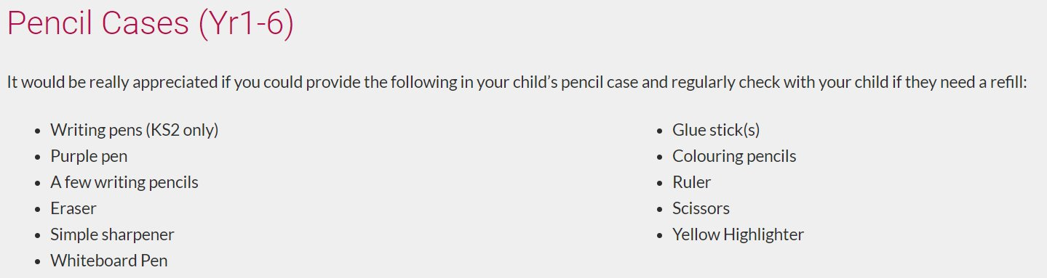
Equipment Required in Year 6
Please ensure your child has a named water bottle in school each day - these can be refilled in the classrooms too.

Slide 14
KS2 SATS
The KS2 SATs are planned by the government for 10th – 13th May 2027.
As ever we will prepare the children for them in school through regular assessments, lessons and interventions.
They reflect the journey of the children through the school. They are not something for the children to be concerned by – they do not affect secondary schools.
The test papers follow a similar format to the Pixl assessments that we complete at the end of each term. If your child has a tutor, please don't use any past SATs papers until we have completed them in school.
Year 6 is about much more than SATs!

Slide 15
Dates for your diary
14th – 18th September = Bikeability
12th – 16th October = Osmington Bay
10th – 14th May = SATs week

Slide 16
Mobile Phone Policy
If your child wishes to bring a brick phone to school, the Mobile Phone Permission letter and agreement must be completed and signed. ​You can find this under the useful forms section of the website.
Phones must be switched off during the school day and remain in their bags.
Children are responsible for the security of their phones. ​
Regular online safety lessons take place in school.

Slide 17
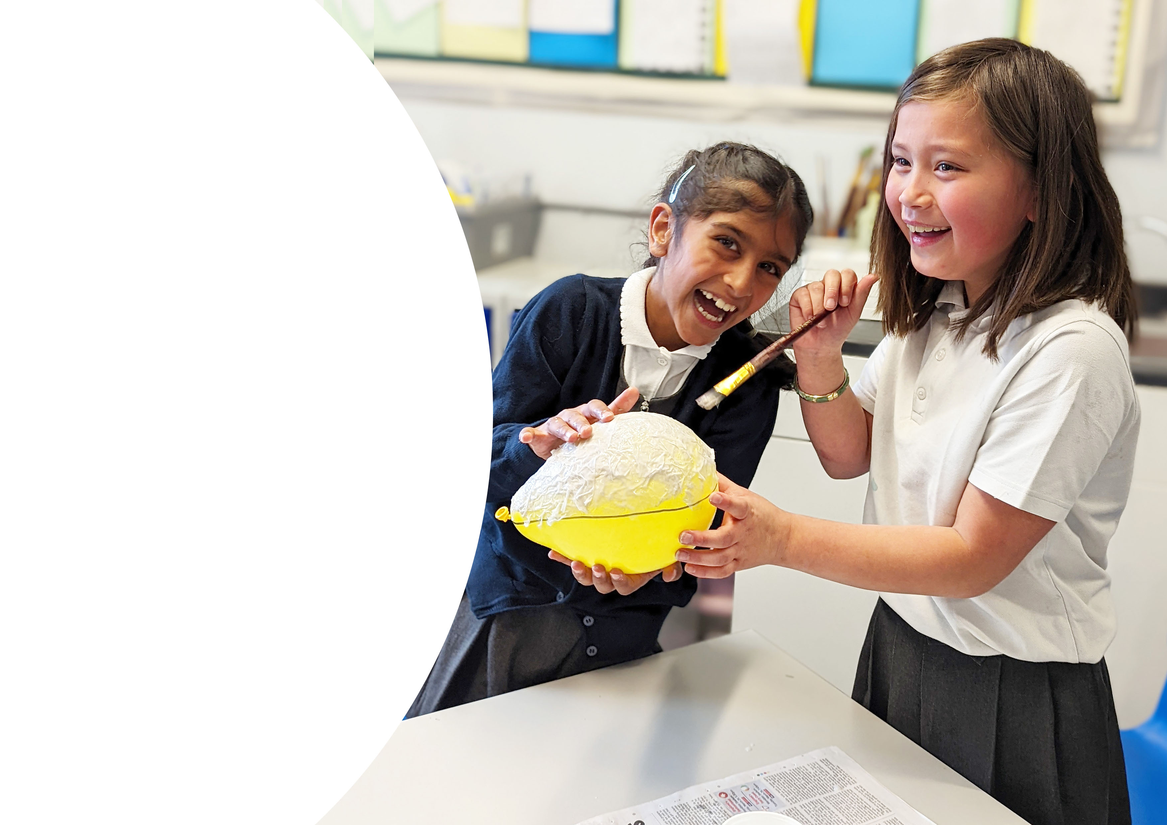
Thank you for your time!
We can't wait to spend your final year at Nine Mile Ride School with you :)

Slide 18

Section Title
Page Title
Text
Bullet
  Bullet

Slide 19
Section Title
Page Title
Text
Bullet
  Bullet
Highlight Title
Bullet

Slide 20
Section Title
Page Title
Text
Bullet
  Bullet

Slide 21

Title
Text
Bullet
  Bullet

Slide 22
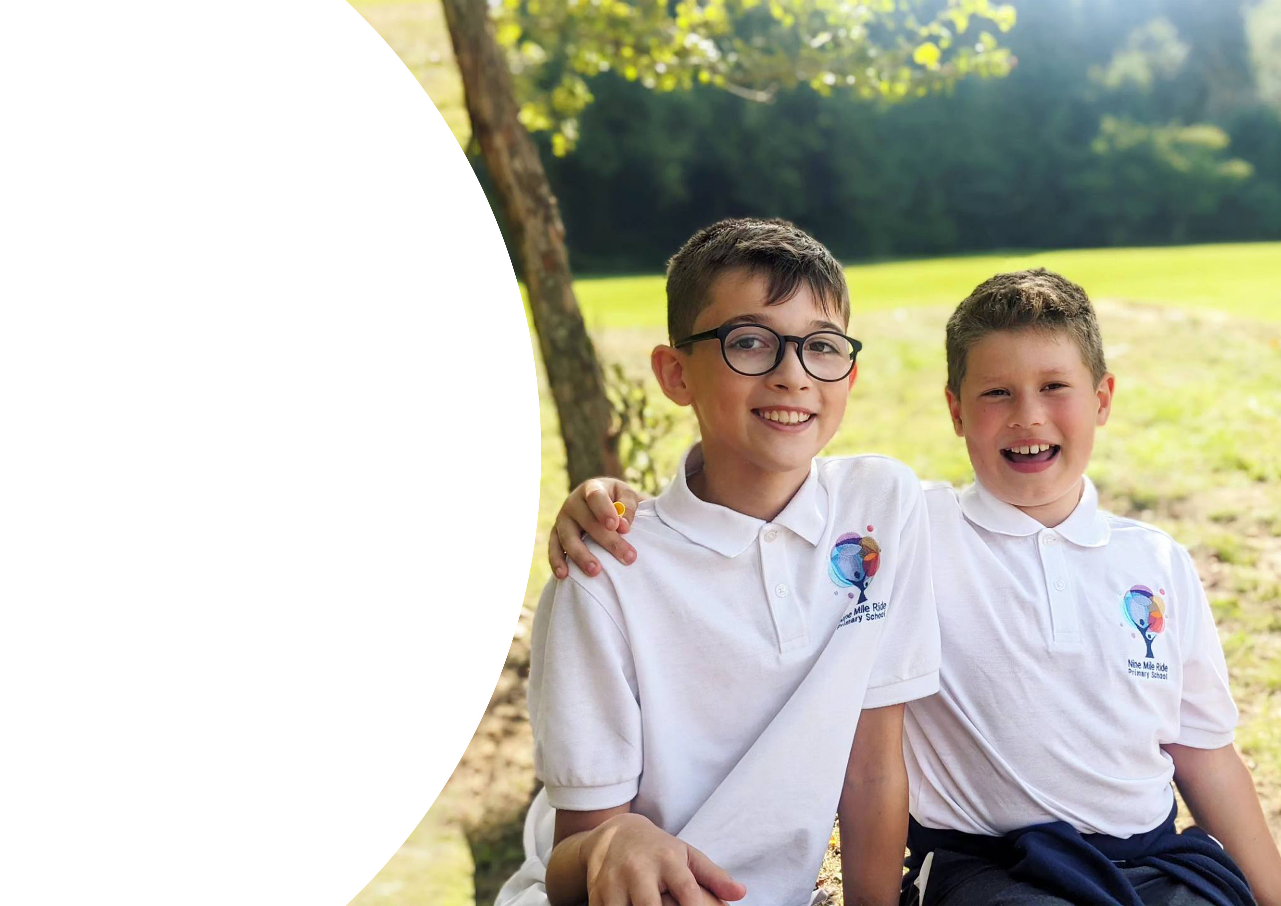
Title
Text
Bullet
  Bullet

Slide 23
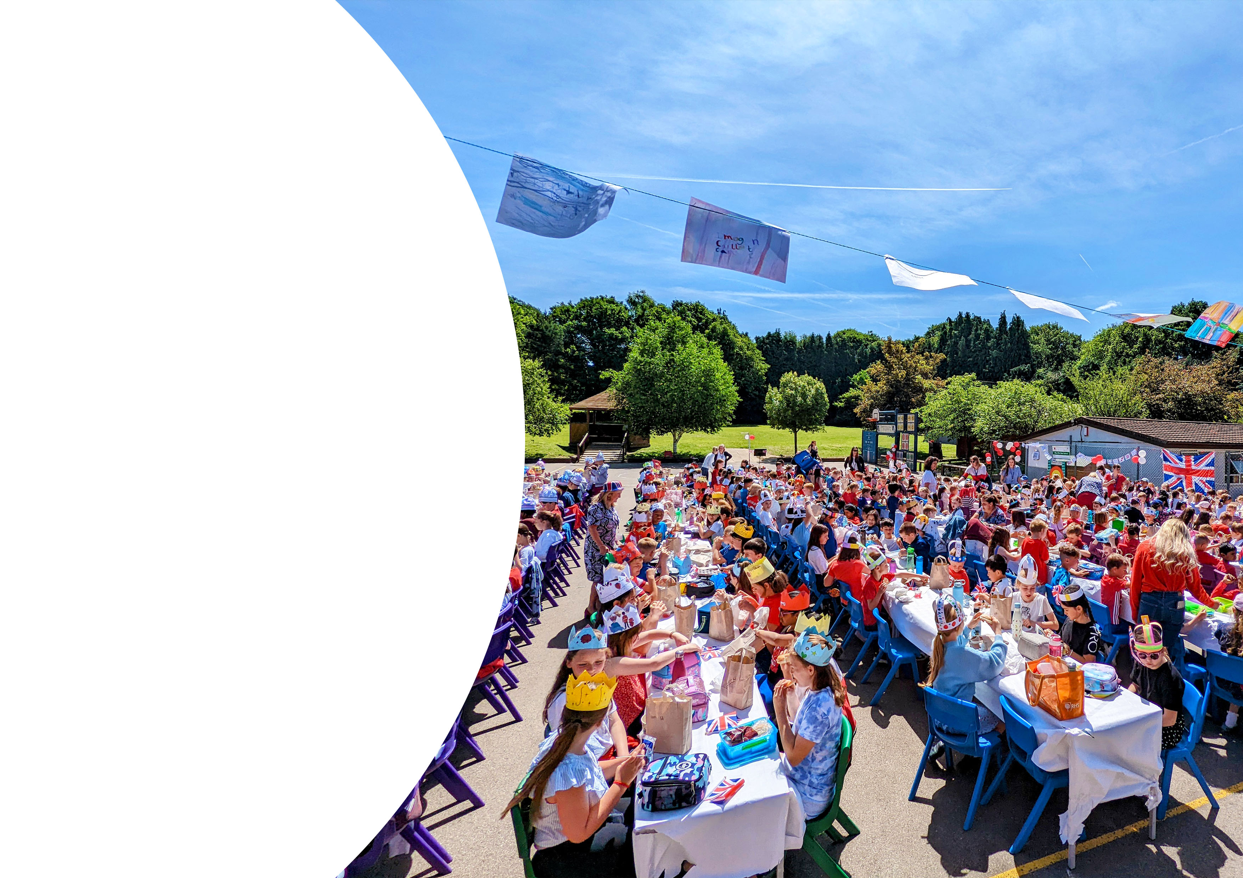
Title
Text
Bullet
  Bullet

Slide 24
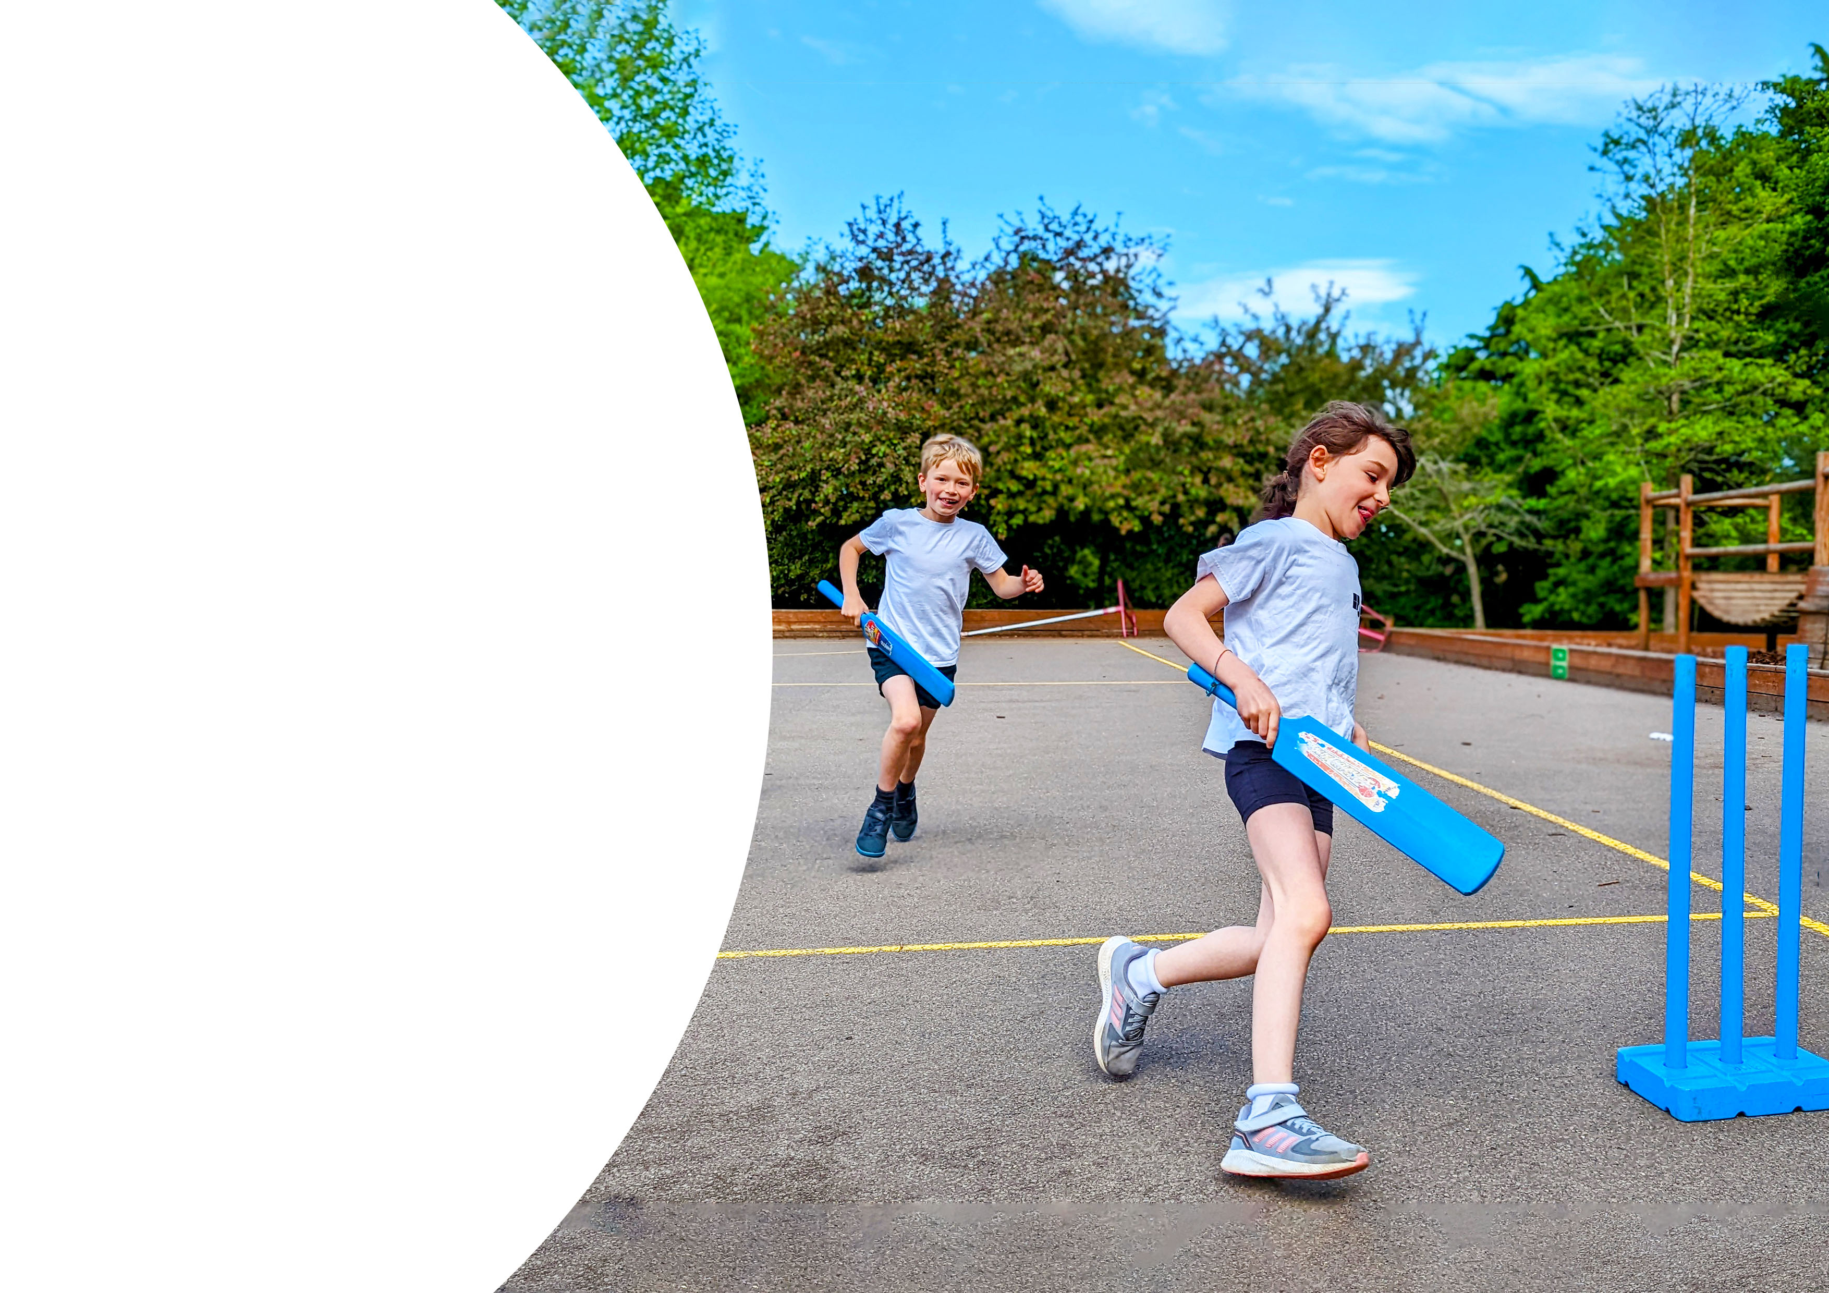
Title
Text
Bullet
  Bullet

Slide 25

Title
Text
Bullet
  Bullet

Slide 26
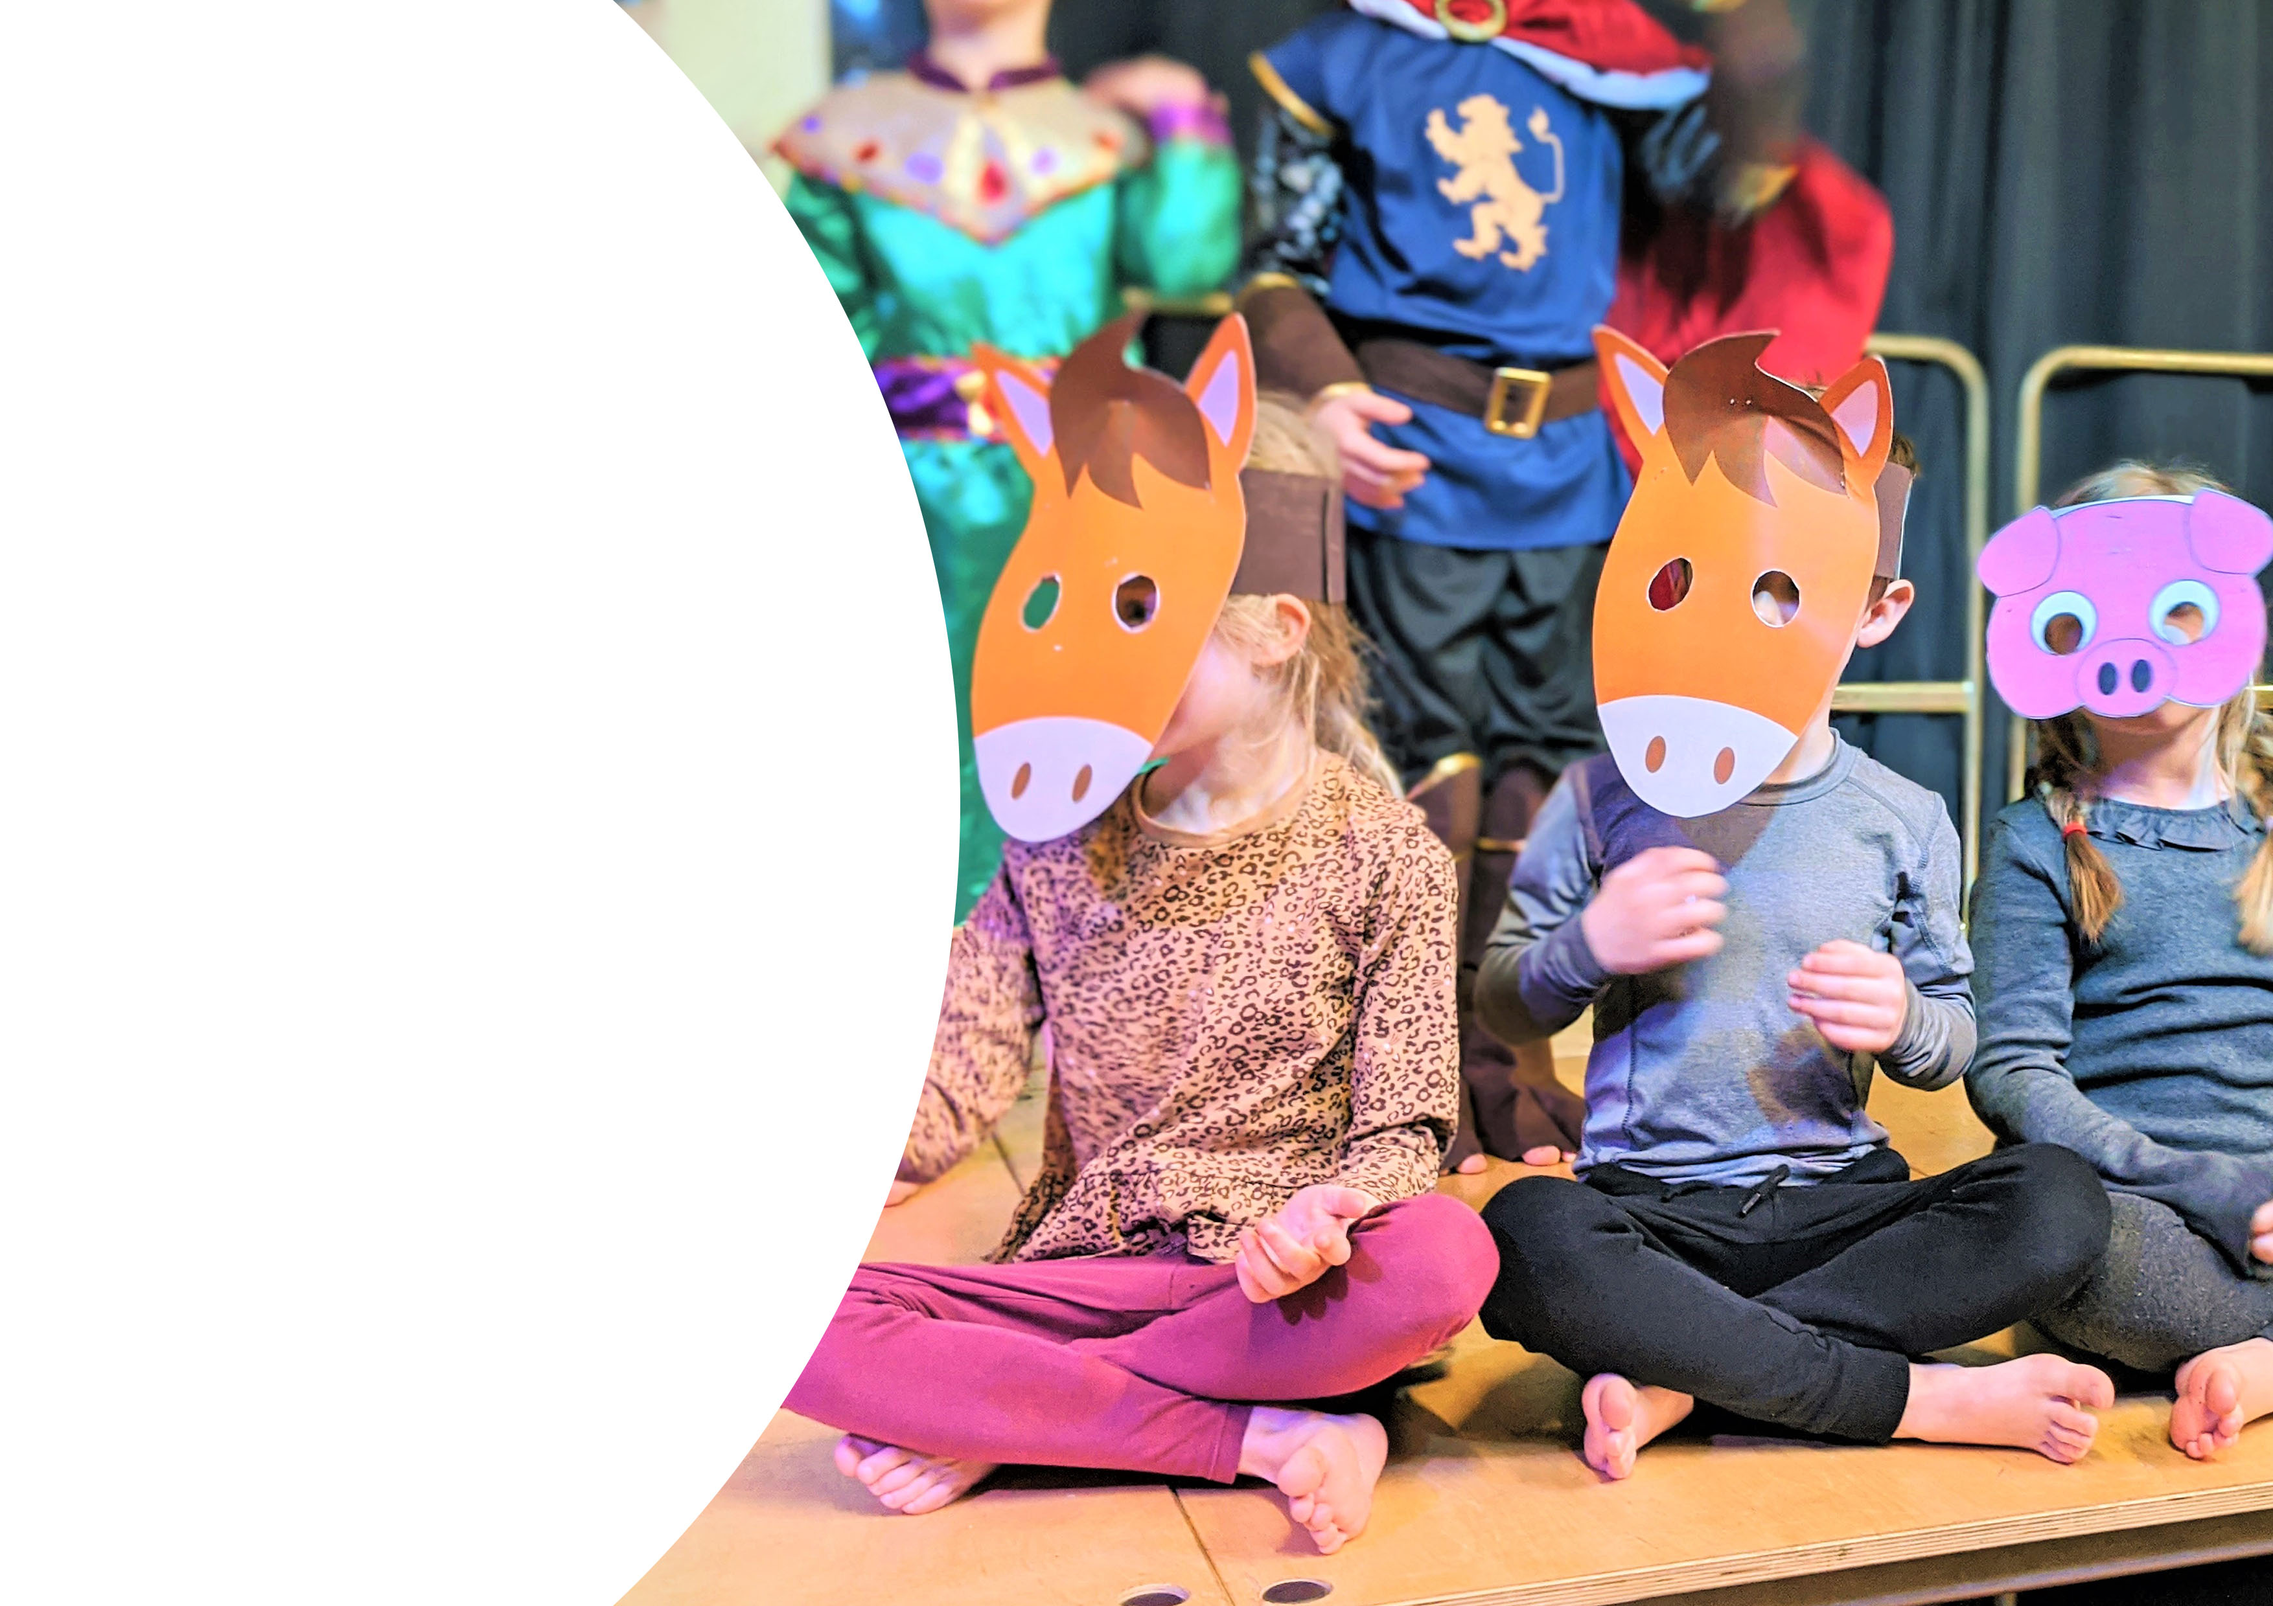
Title
Text
Bullet
  Bullet

Slide 27

Title
Text
Bullet
  Bullet

Slide 28

Title
Text
Bullet
  Bullet

Slide 29

Title
Text
Bullet
  Bullet

Slide 30
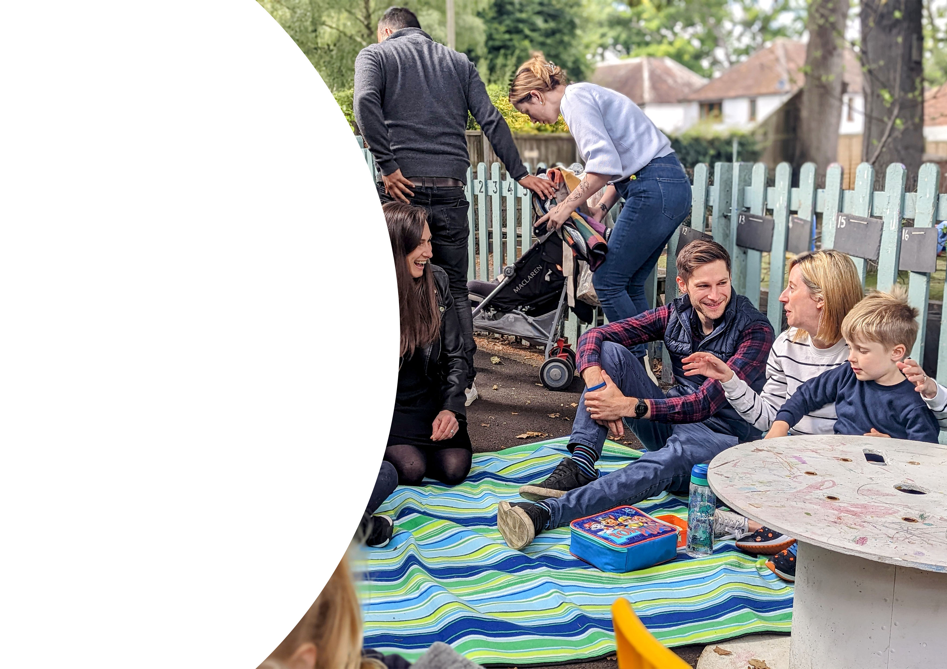
Title
Text
Bullet
  Bullet

Slide 31
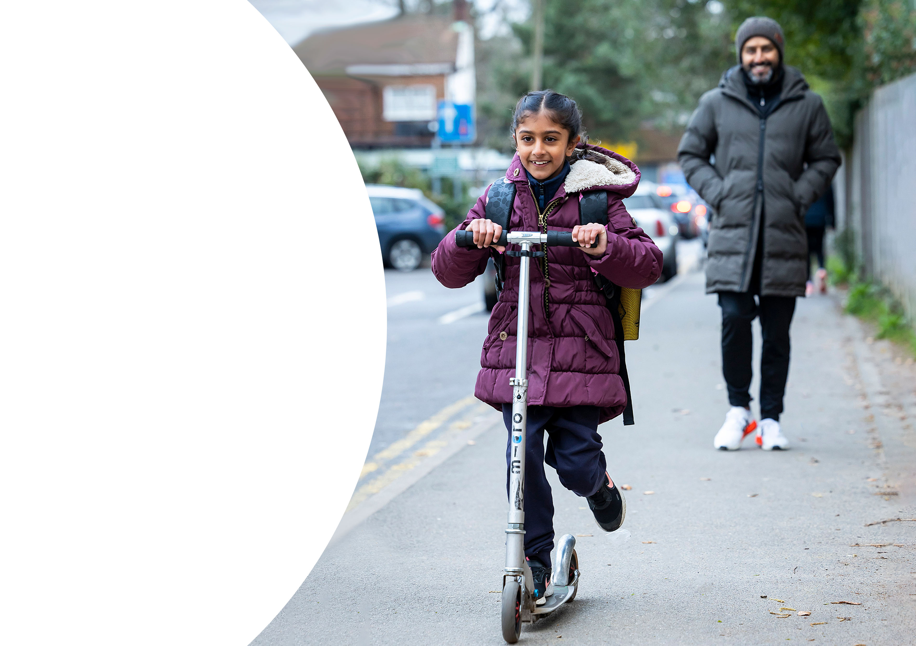
Title
Text
Bullet
  Bullet

